Slide 1


SAROKAR NAI DISHAYEN WELFARE SOCIETY
“Every act of kindness is charity”

Slide 2



Slide 3

Mission
To establish an equitable society where there is no discrimination on the basis of gender, race, religion and caste and which provides equal social, economic and political opportunities

Slide 4
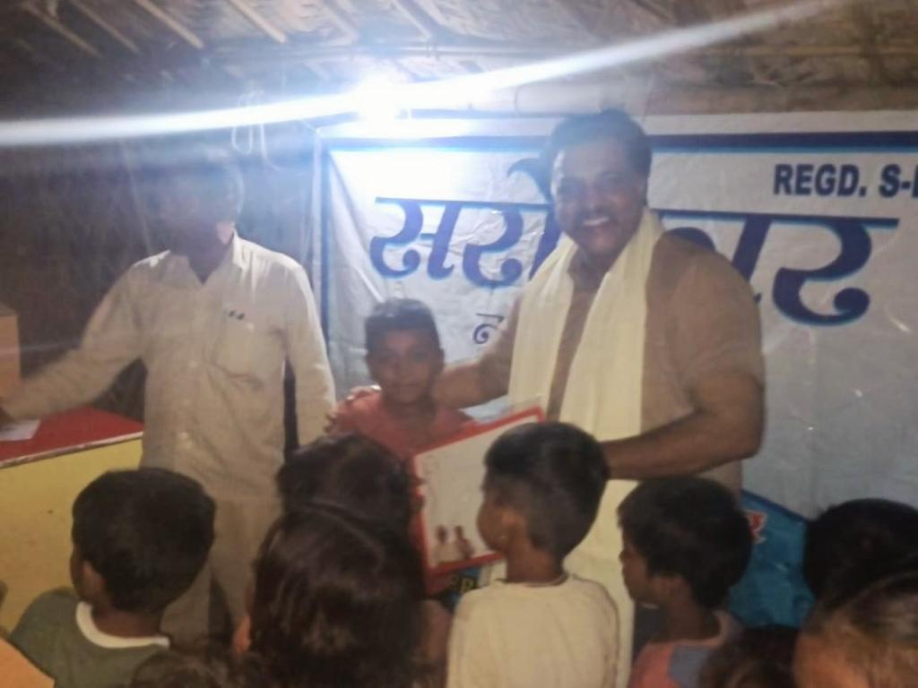
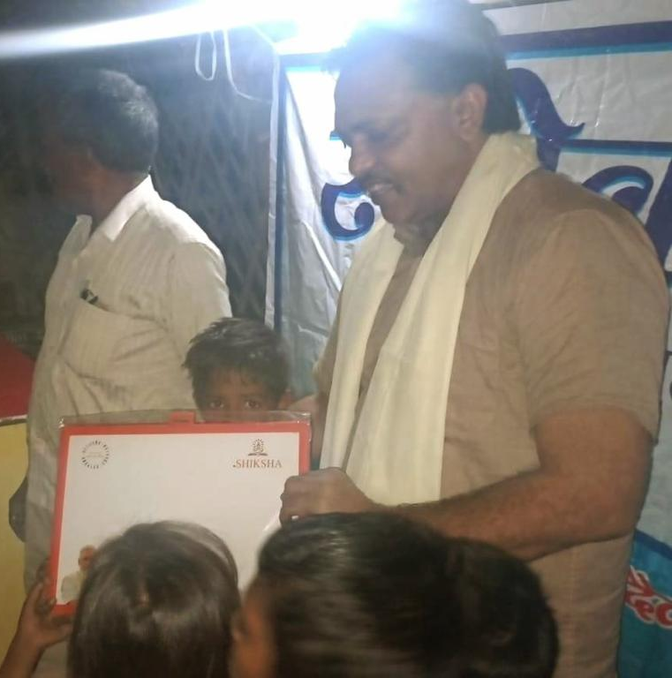

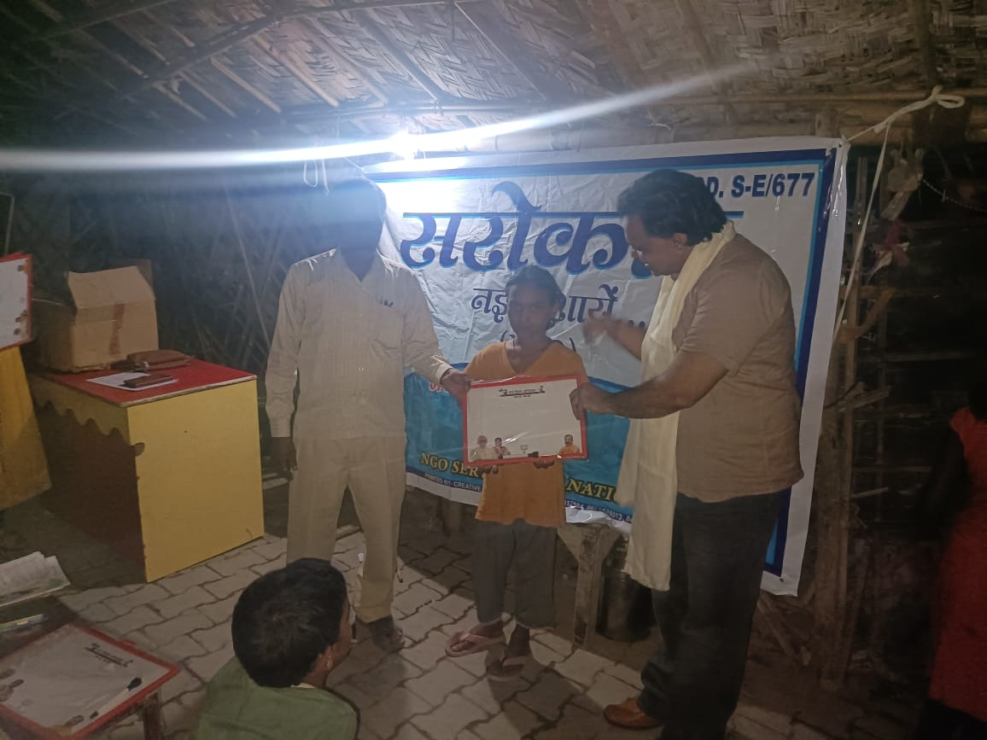

Slide 5
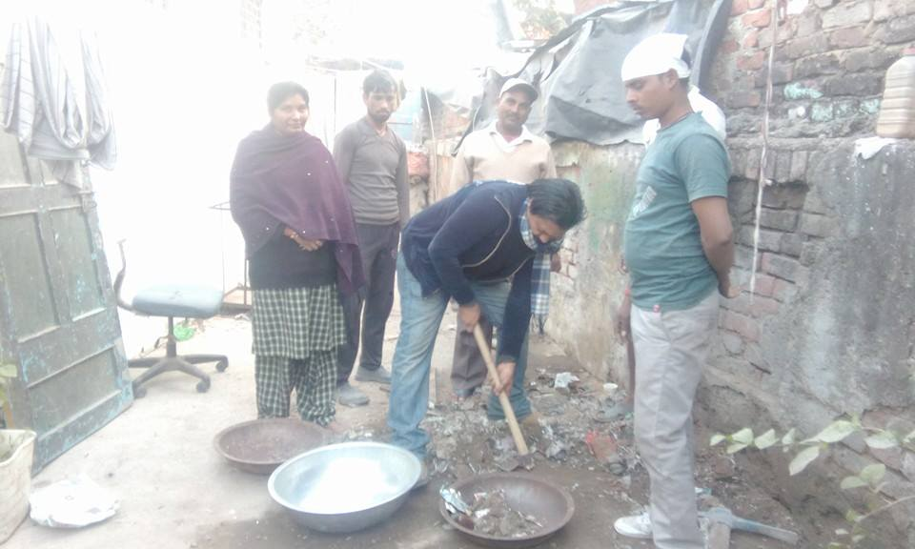
Swachh Bharat Abhiyan

Slide 6

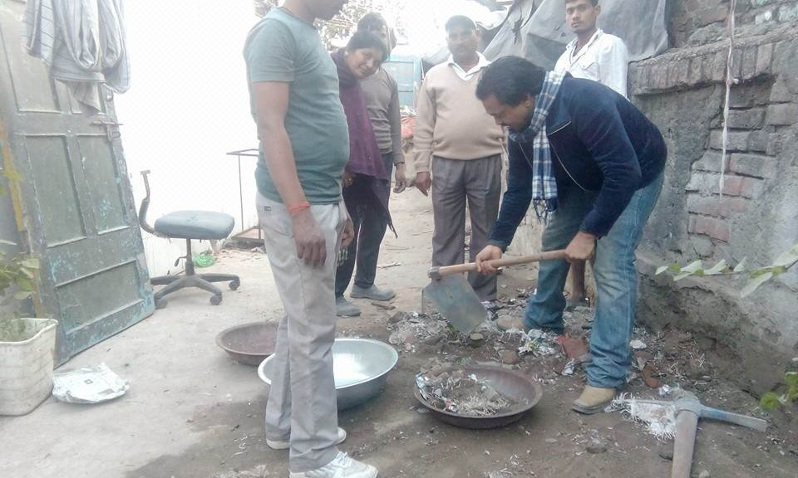

Slide 7
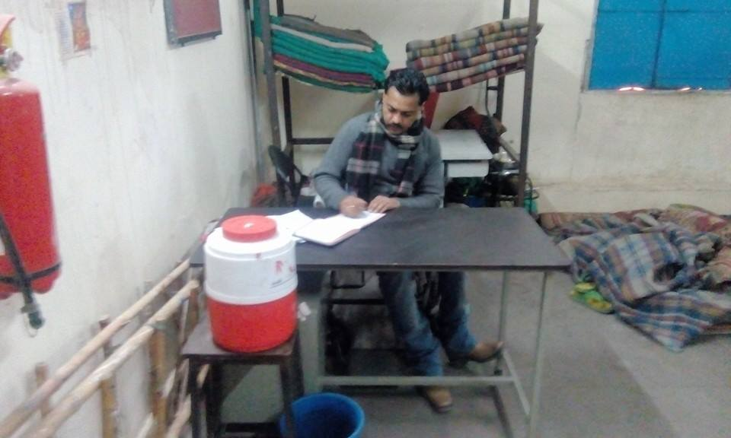
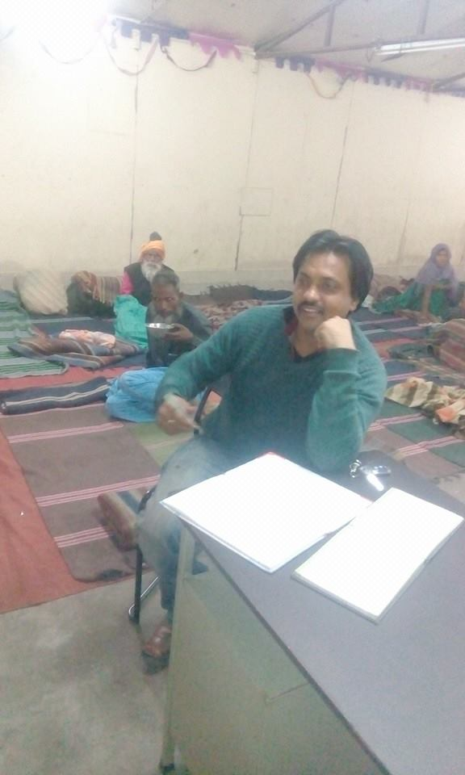
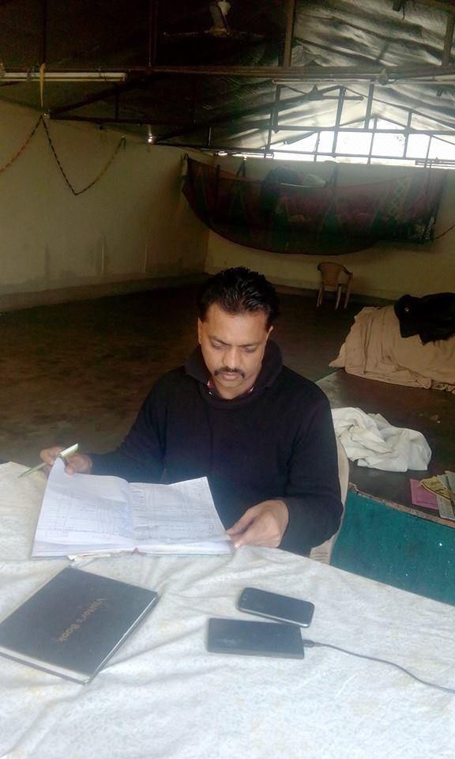
Shelter Homes

Slide 8
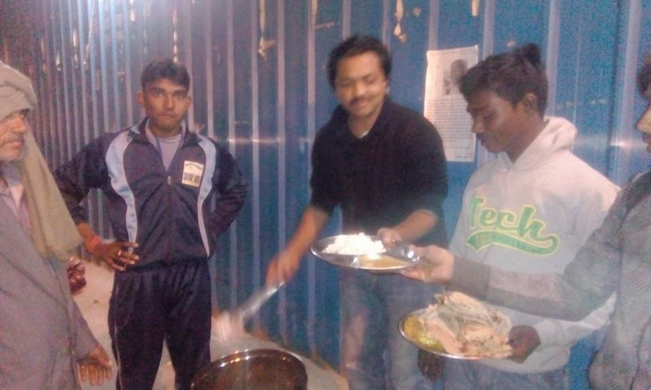
Feeding the people

Slide 9

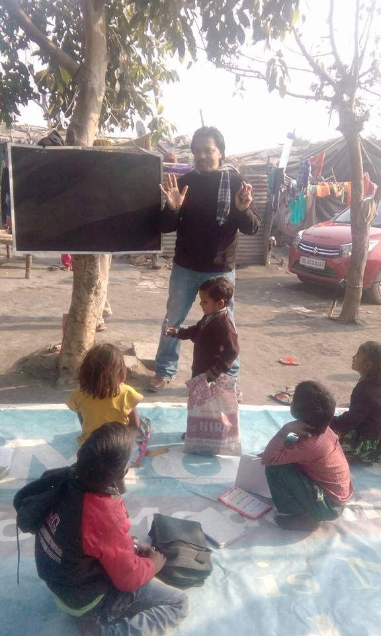
“Padhega India
Bhadega India”

Slide 10
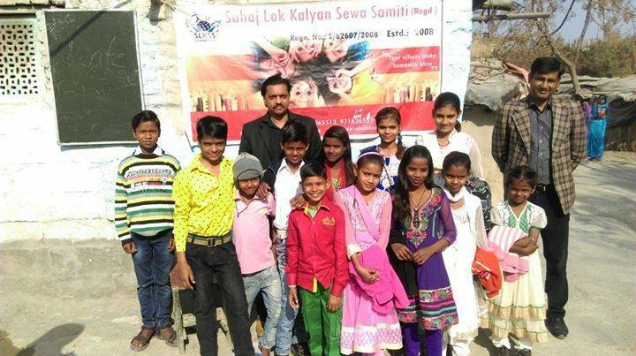
Let’s study…

Slide 11
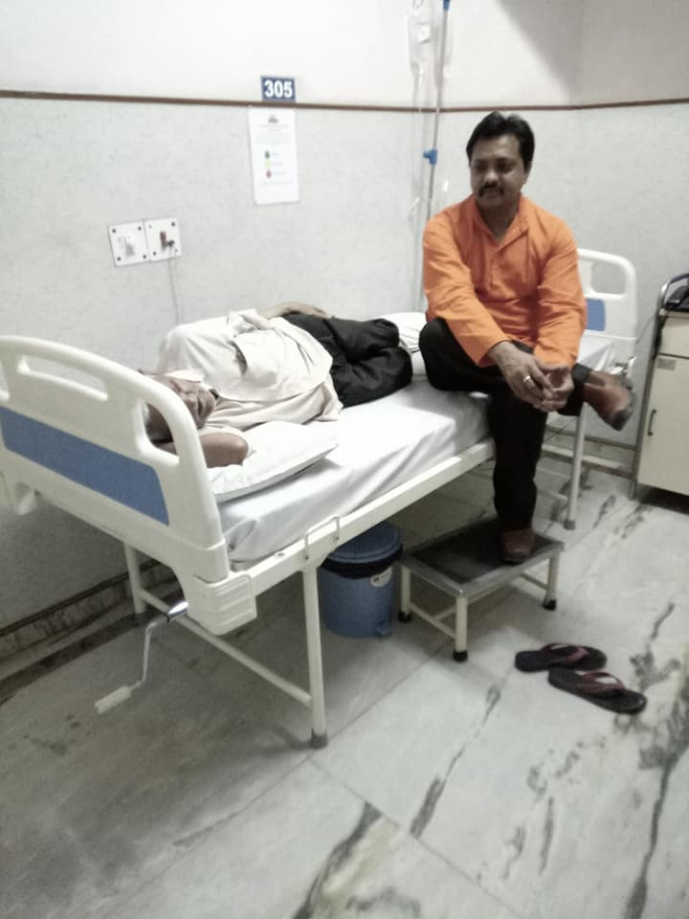
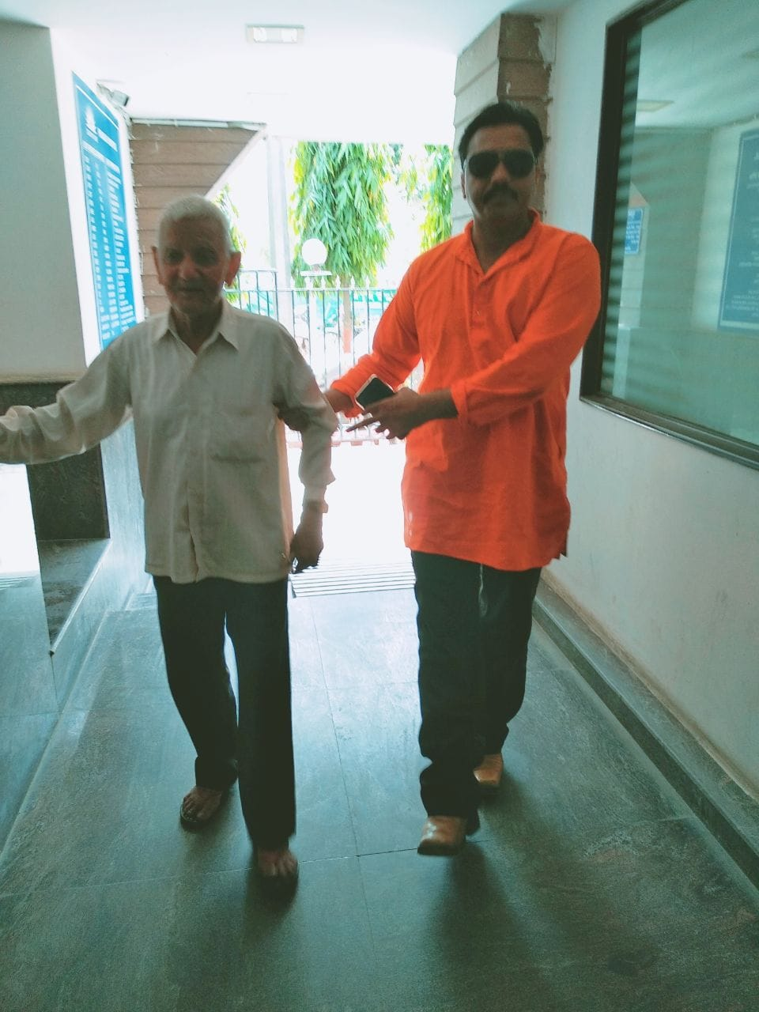
Serving others

Slide 12
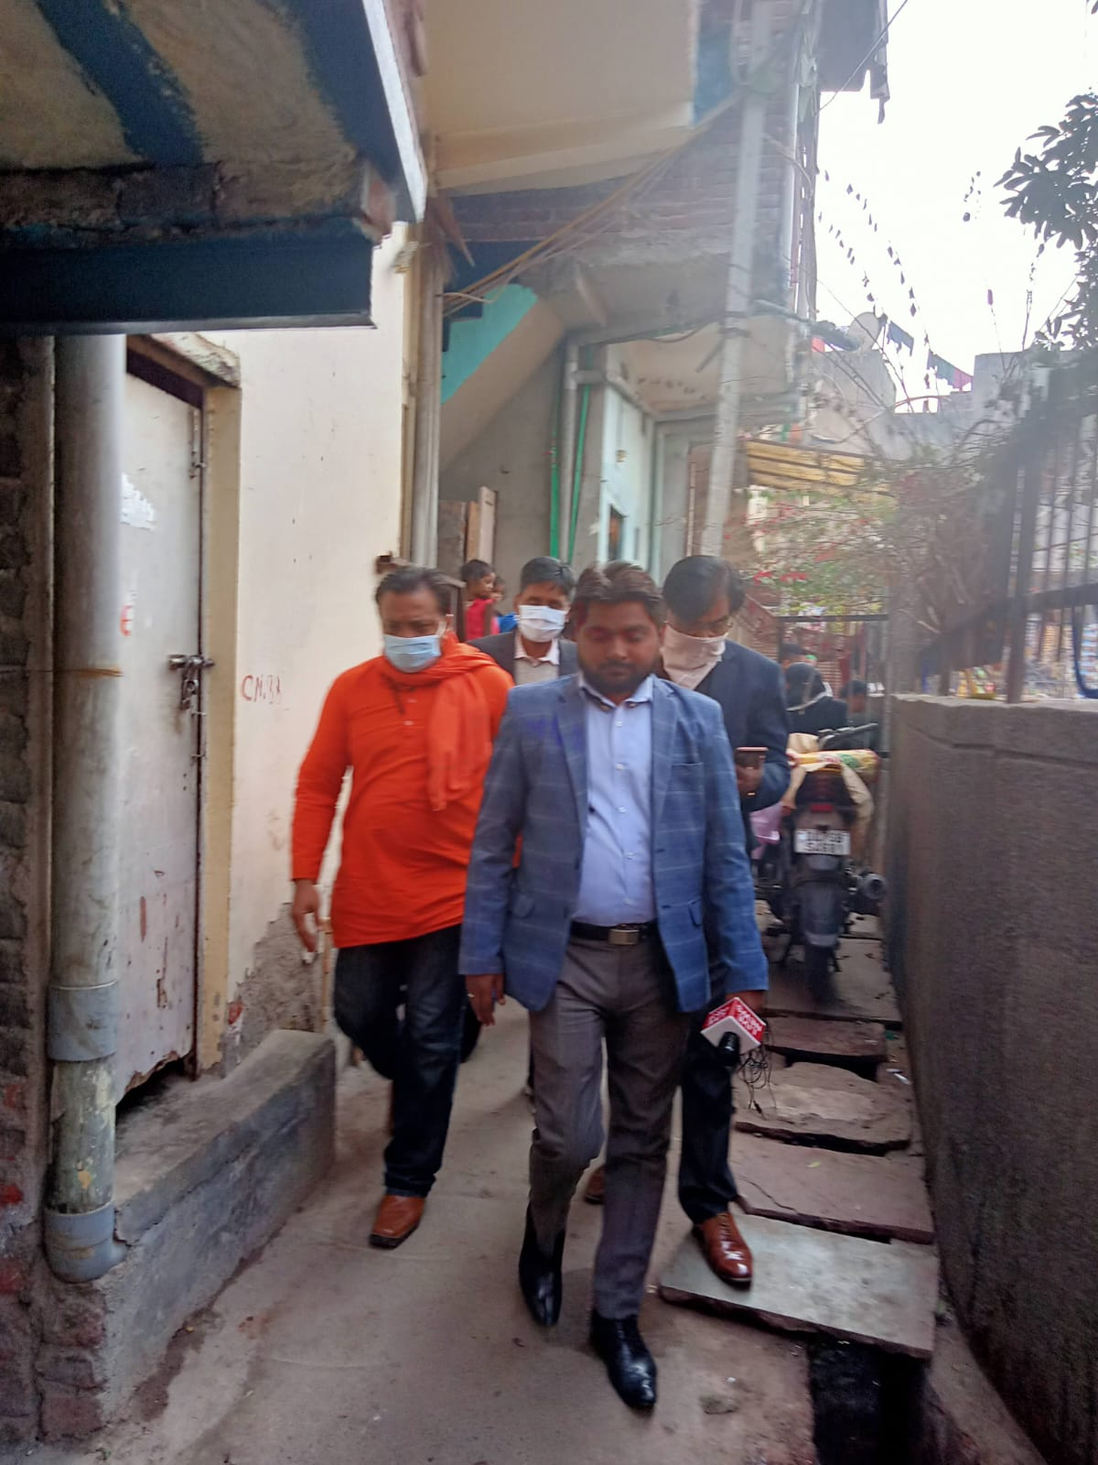
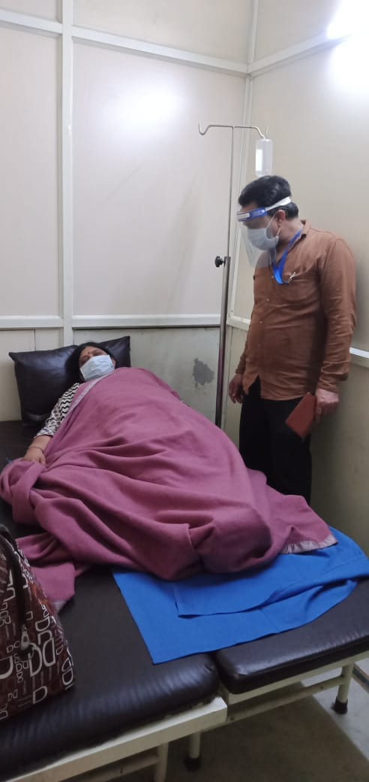
COVID Times-Testing Times

Slide 13
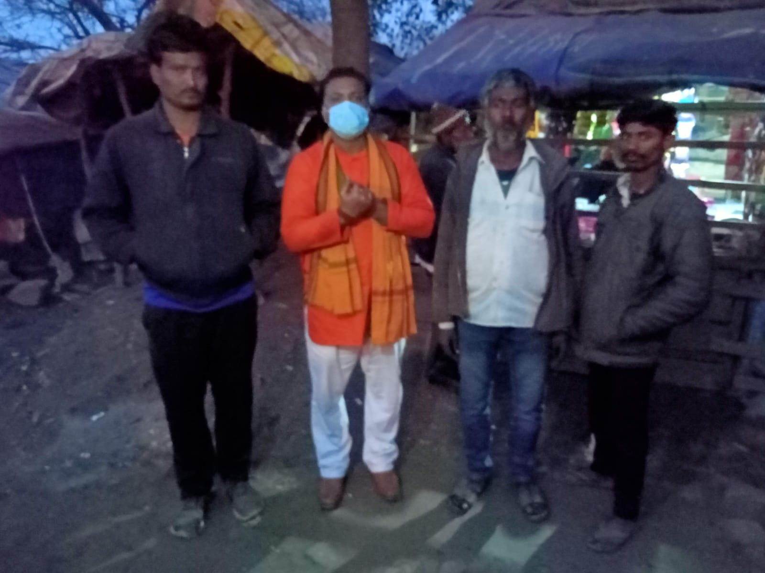
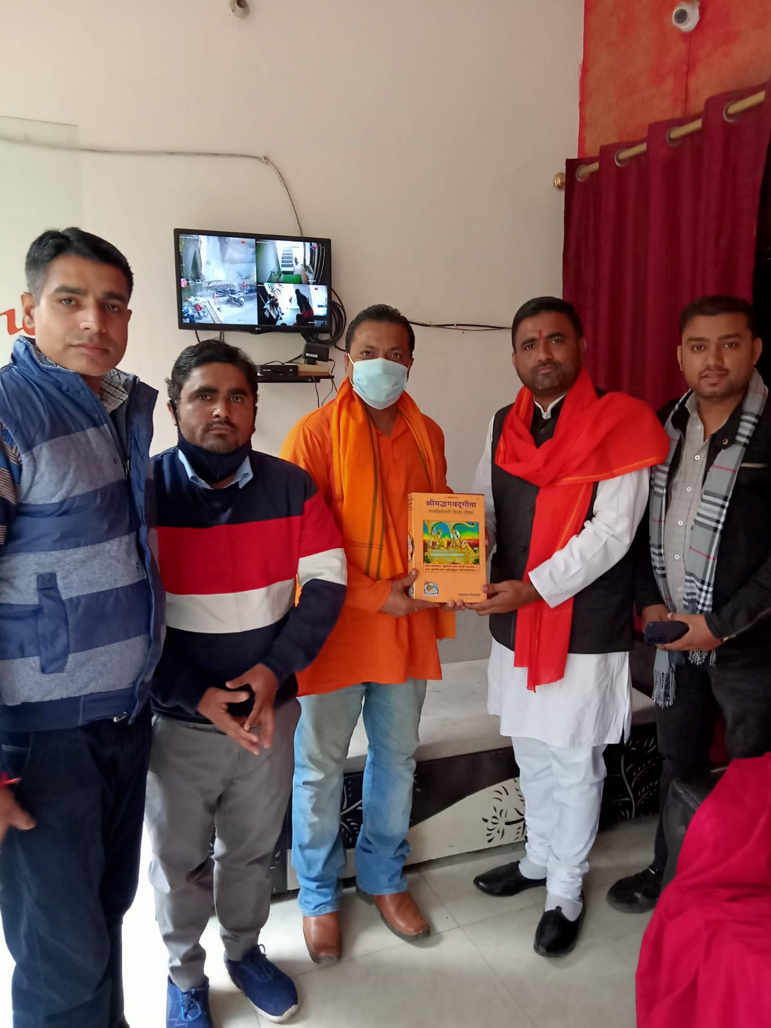
Covid Times

Slide 14
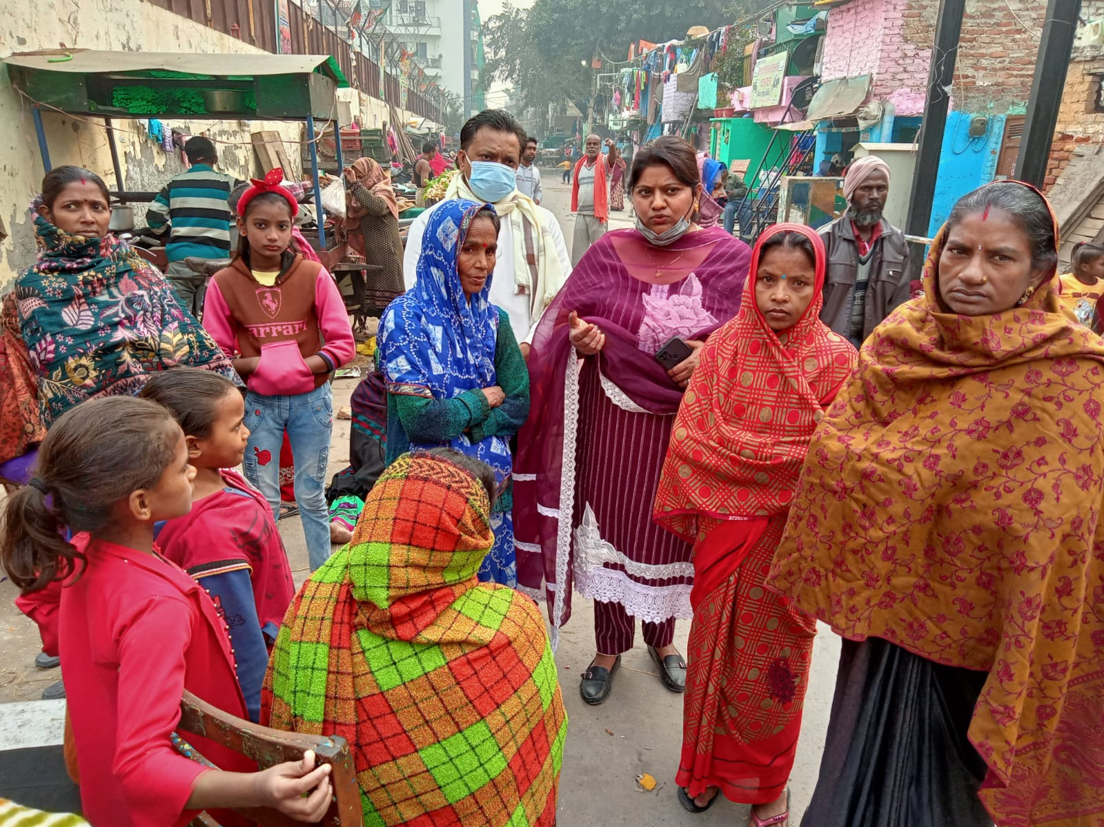
Covid Times

Slide 15
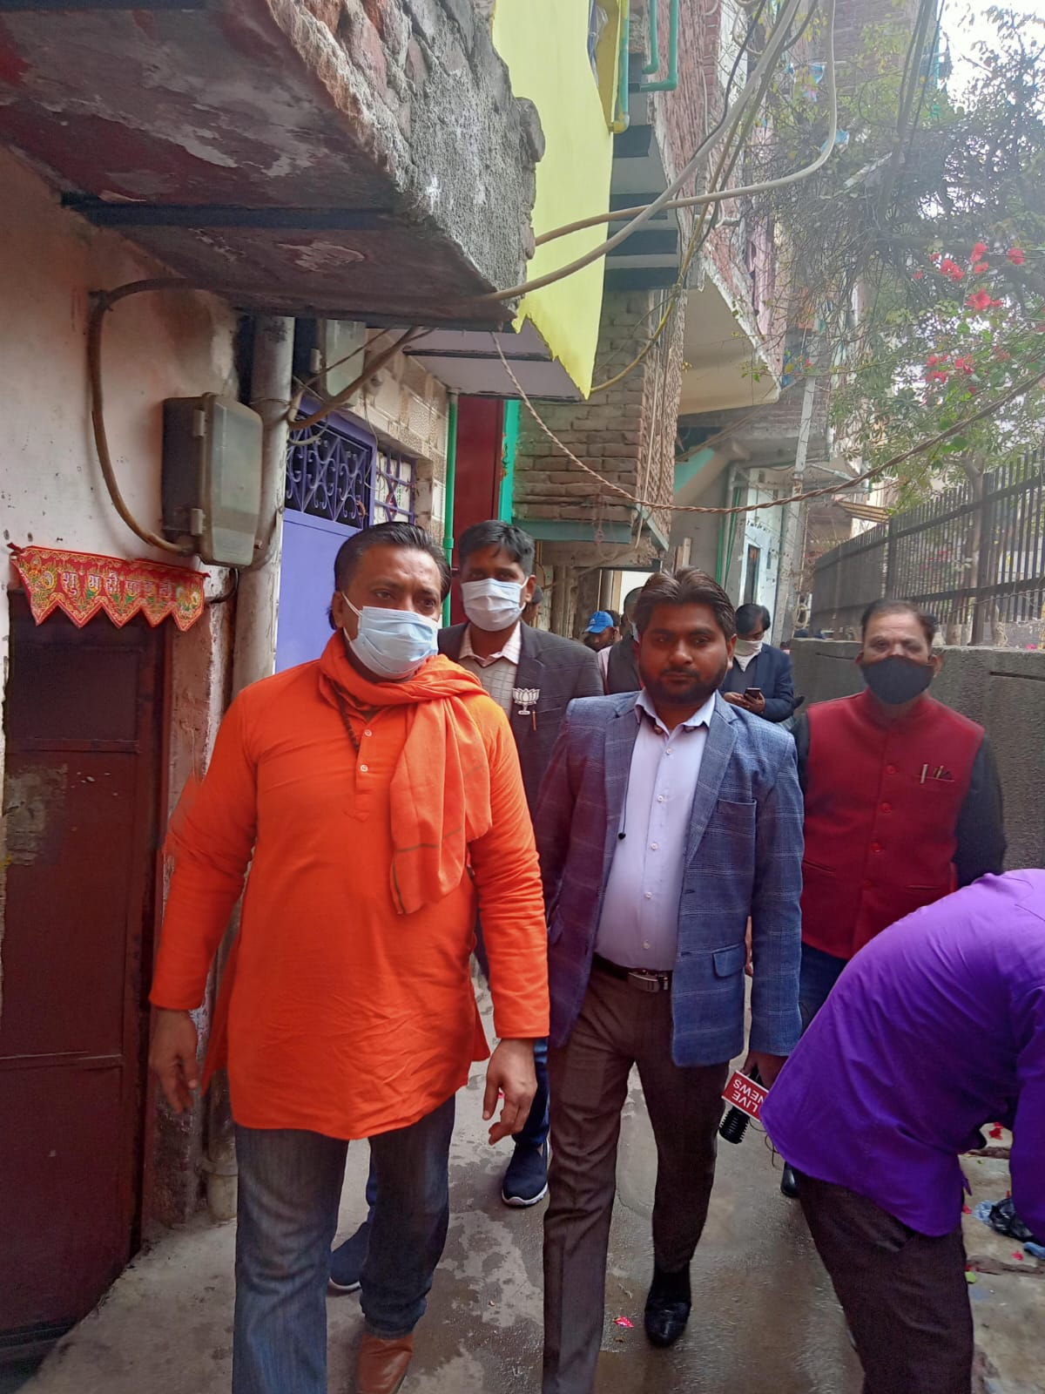
Covid Times

Slide 16
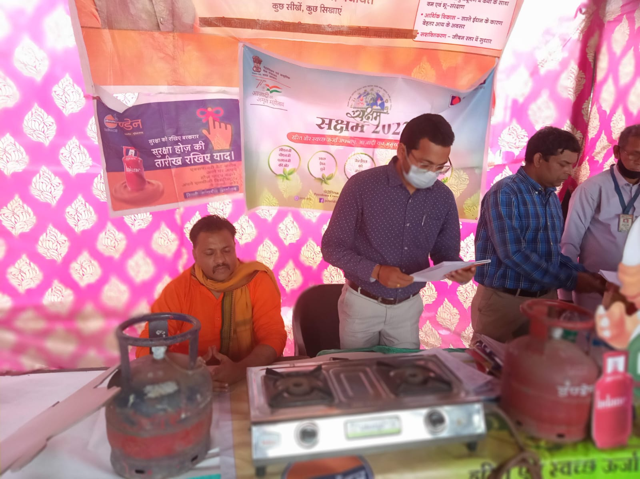
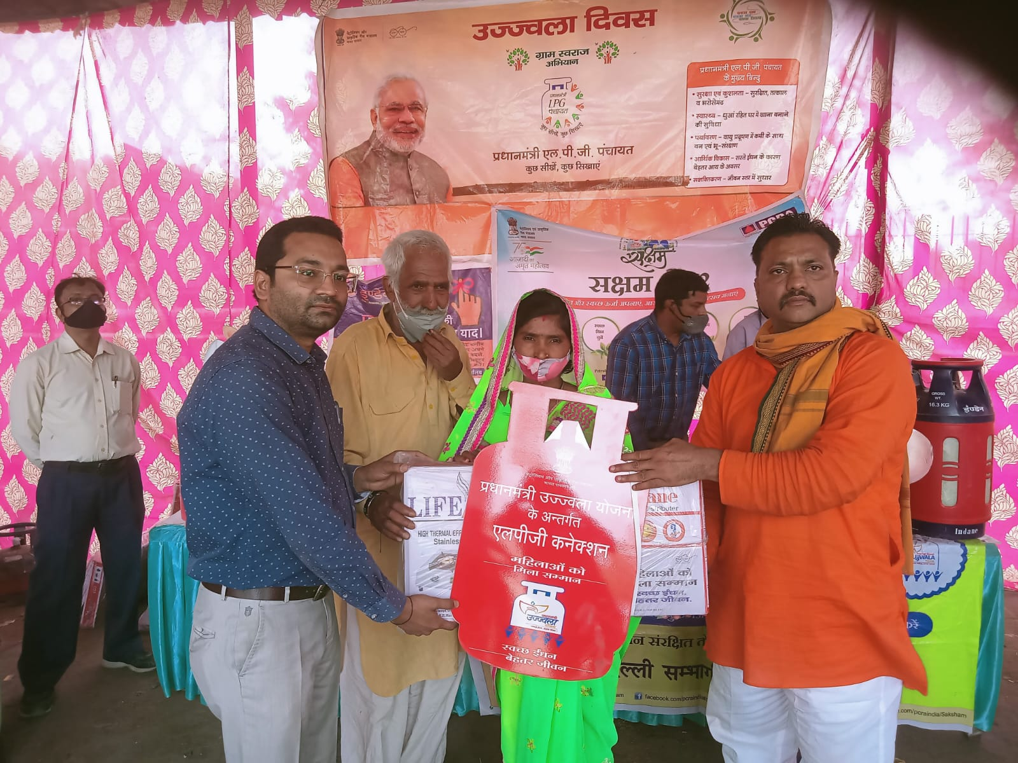
Helping the needy

Slide 17
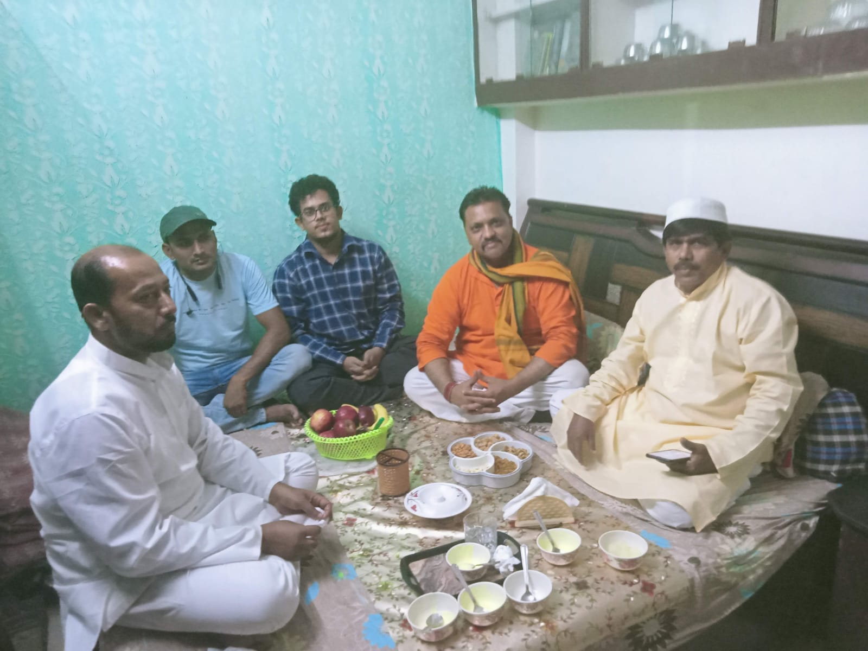
Harmony

Slide 18
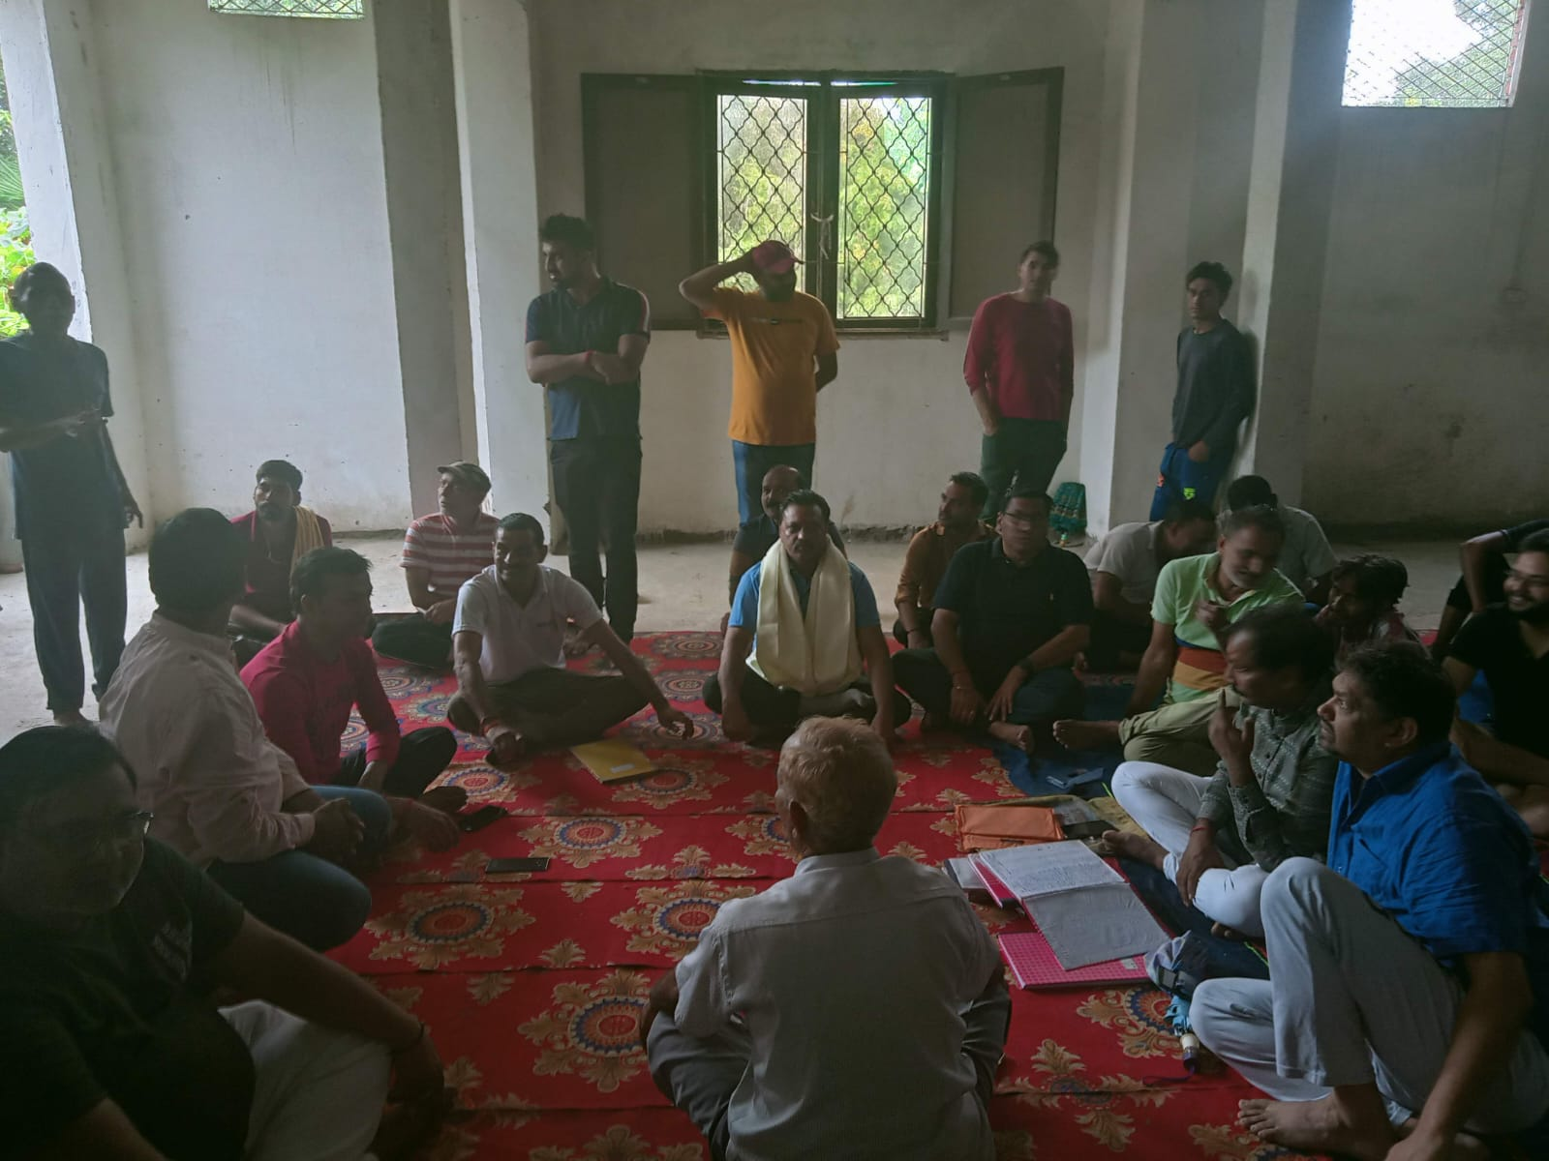
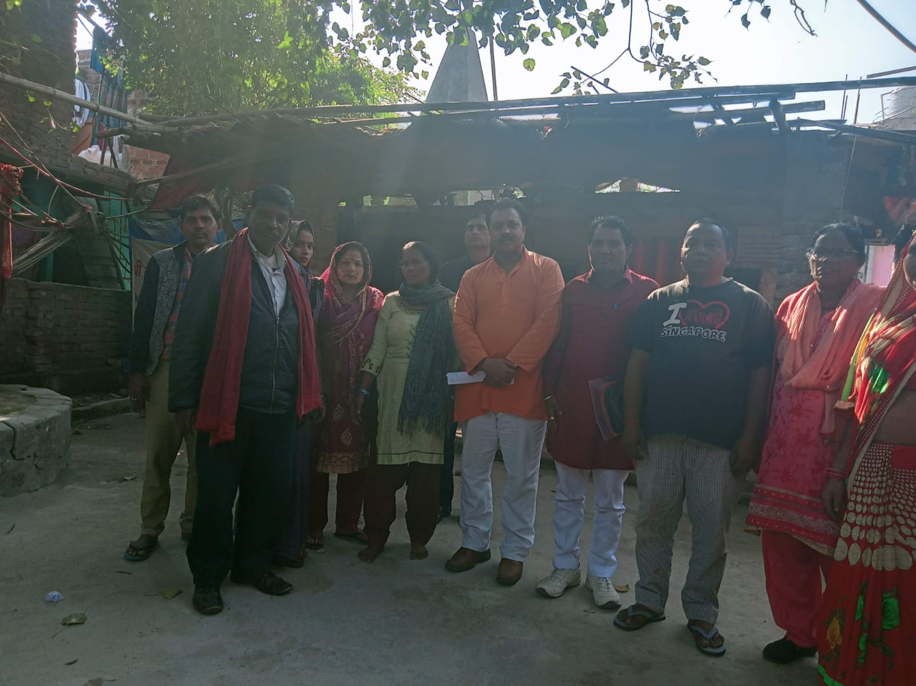
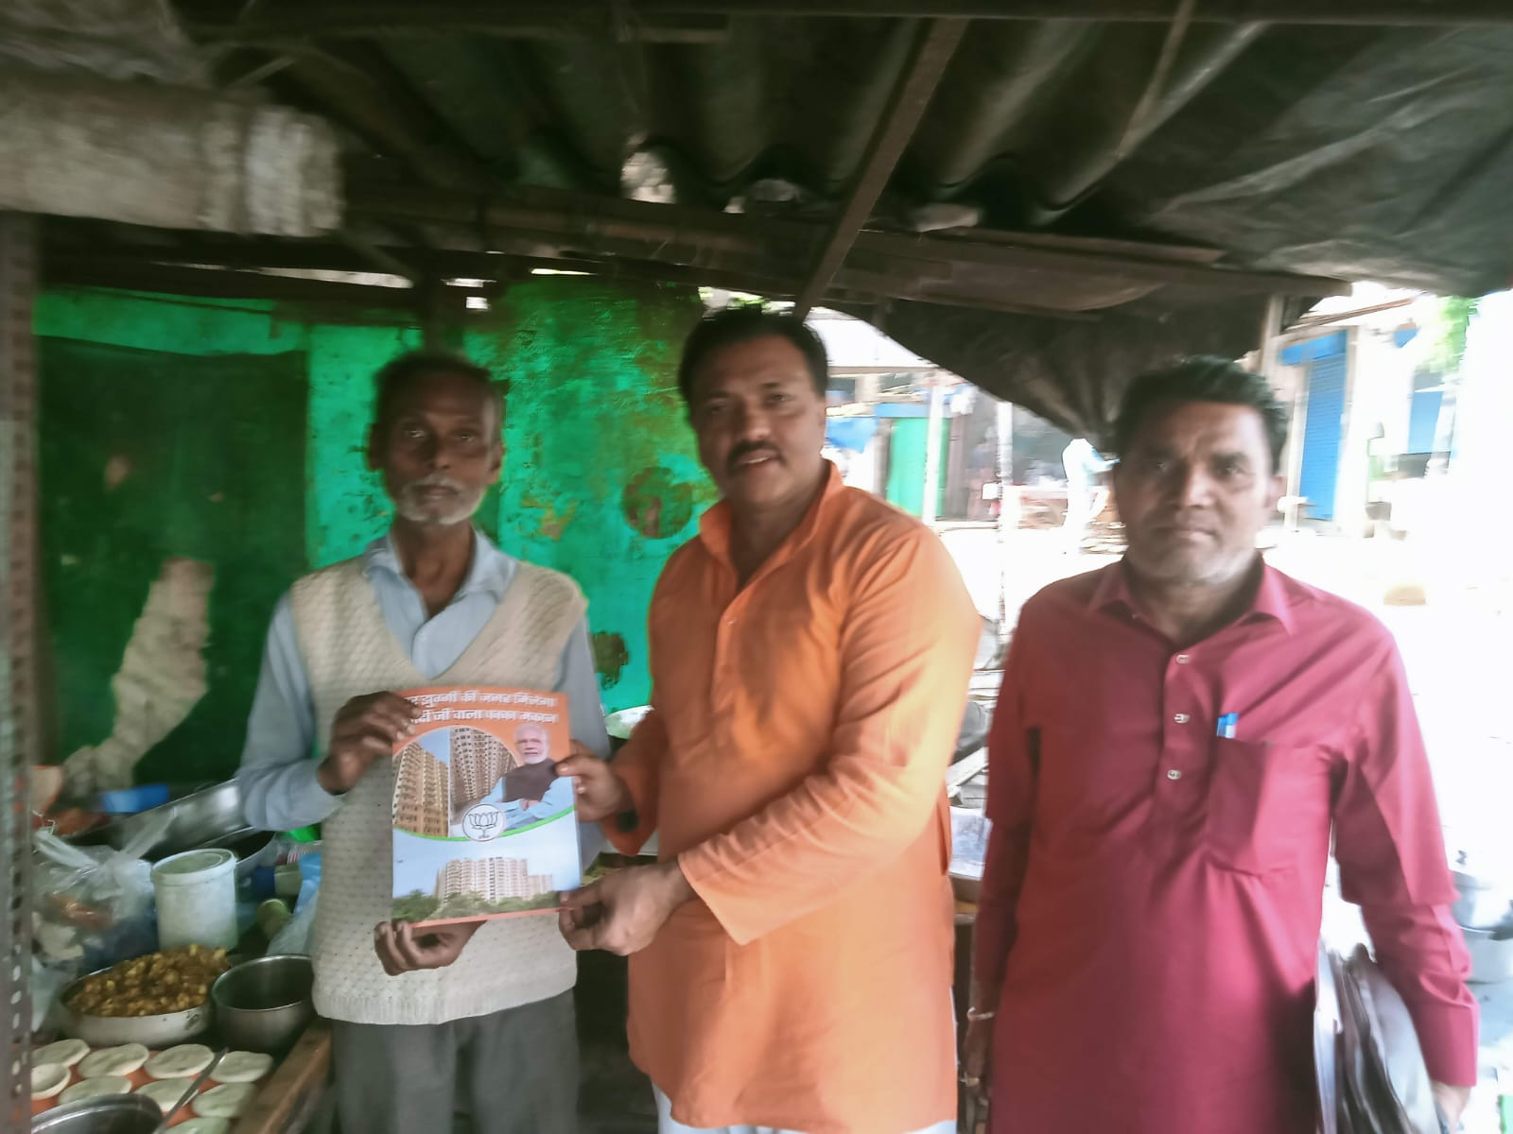
Helping all..

Slide 19
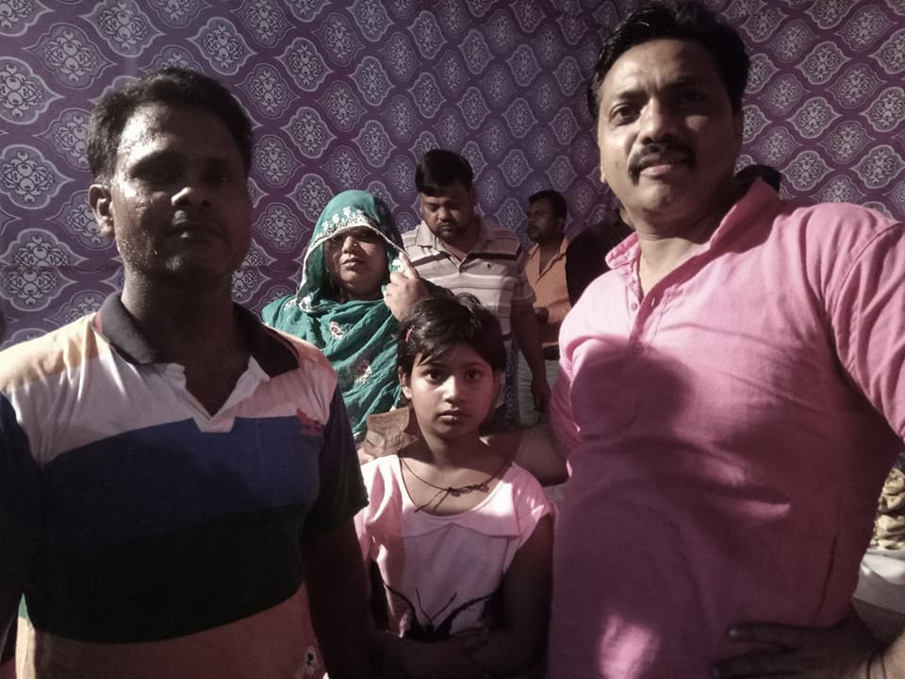

Slide 20
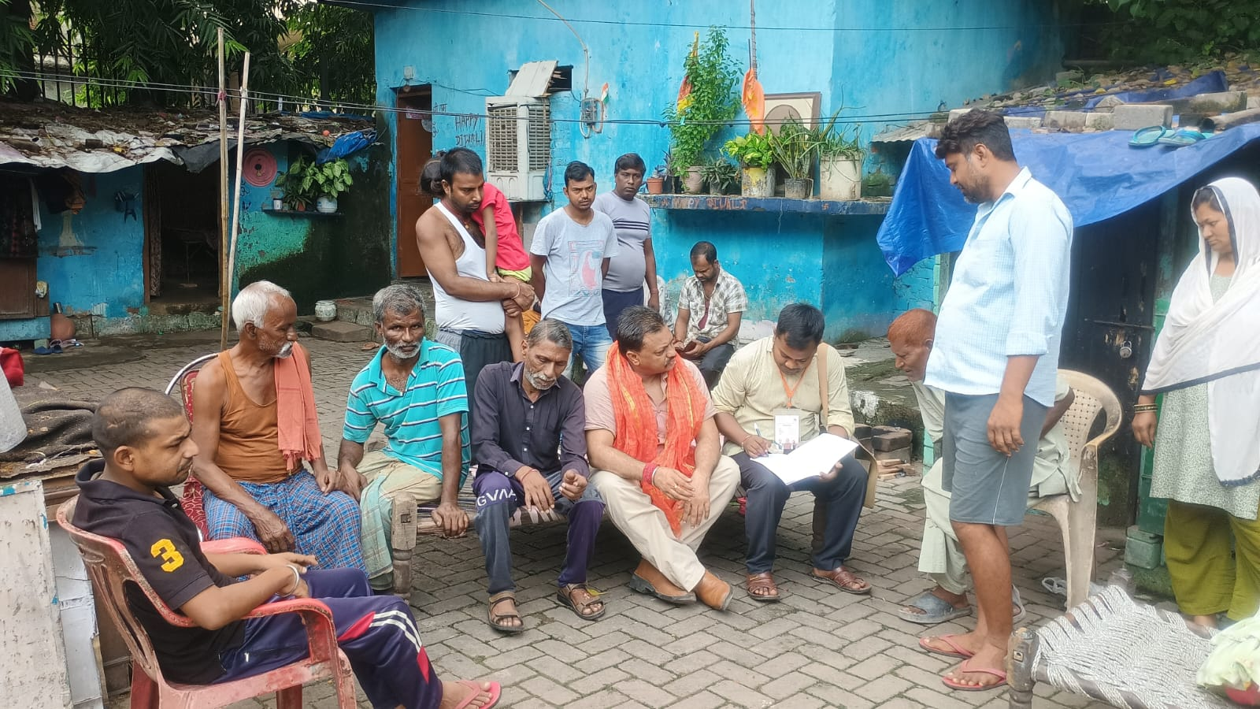
Problem solving…

Slide 21
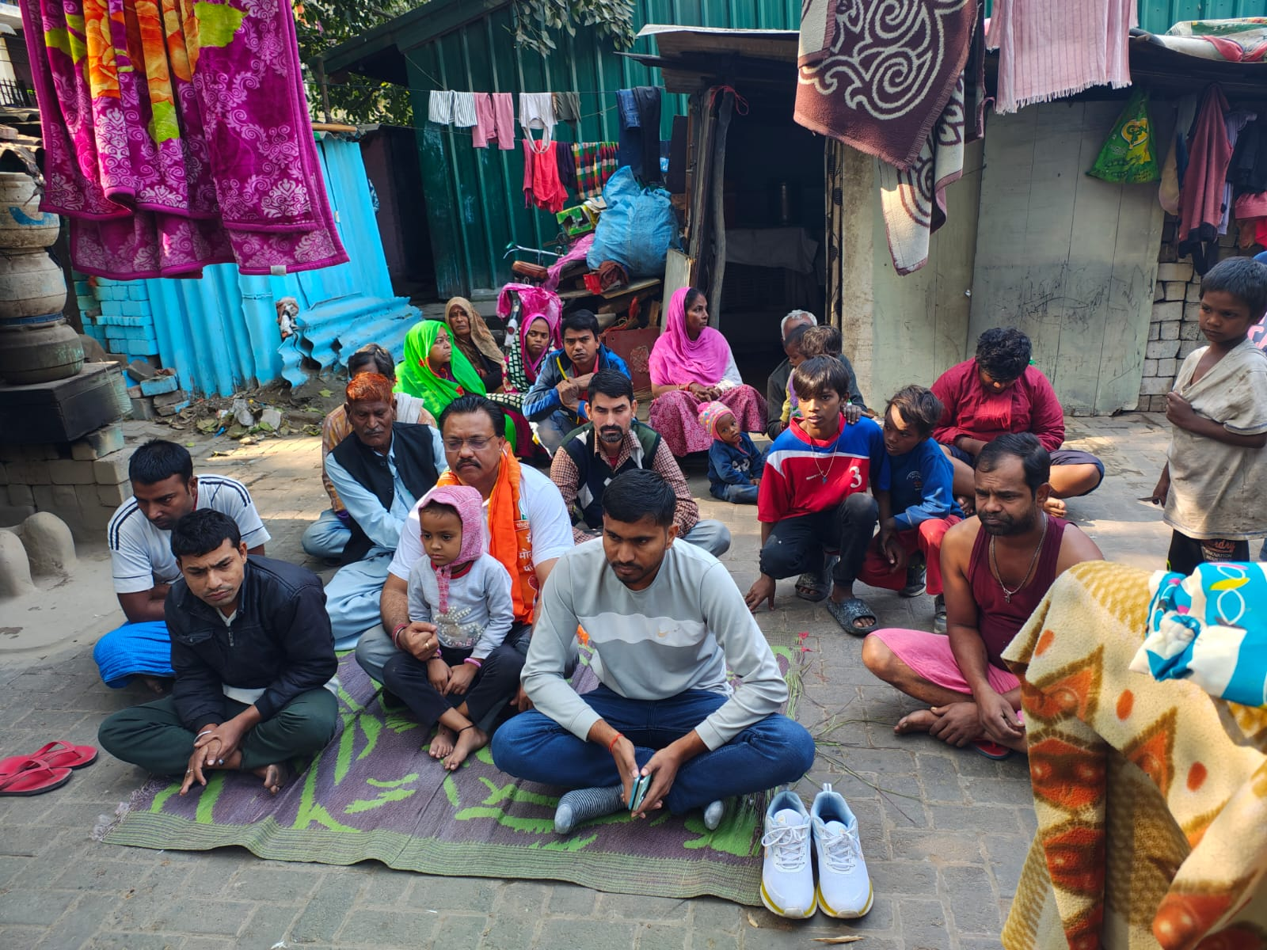
Love & Affection

Slide 22
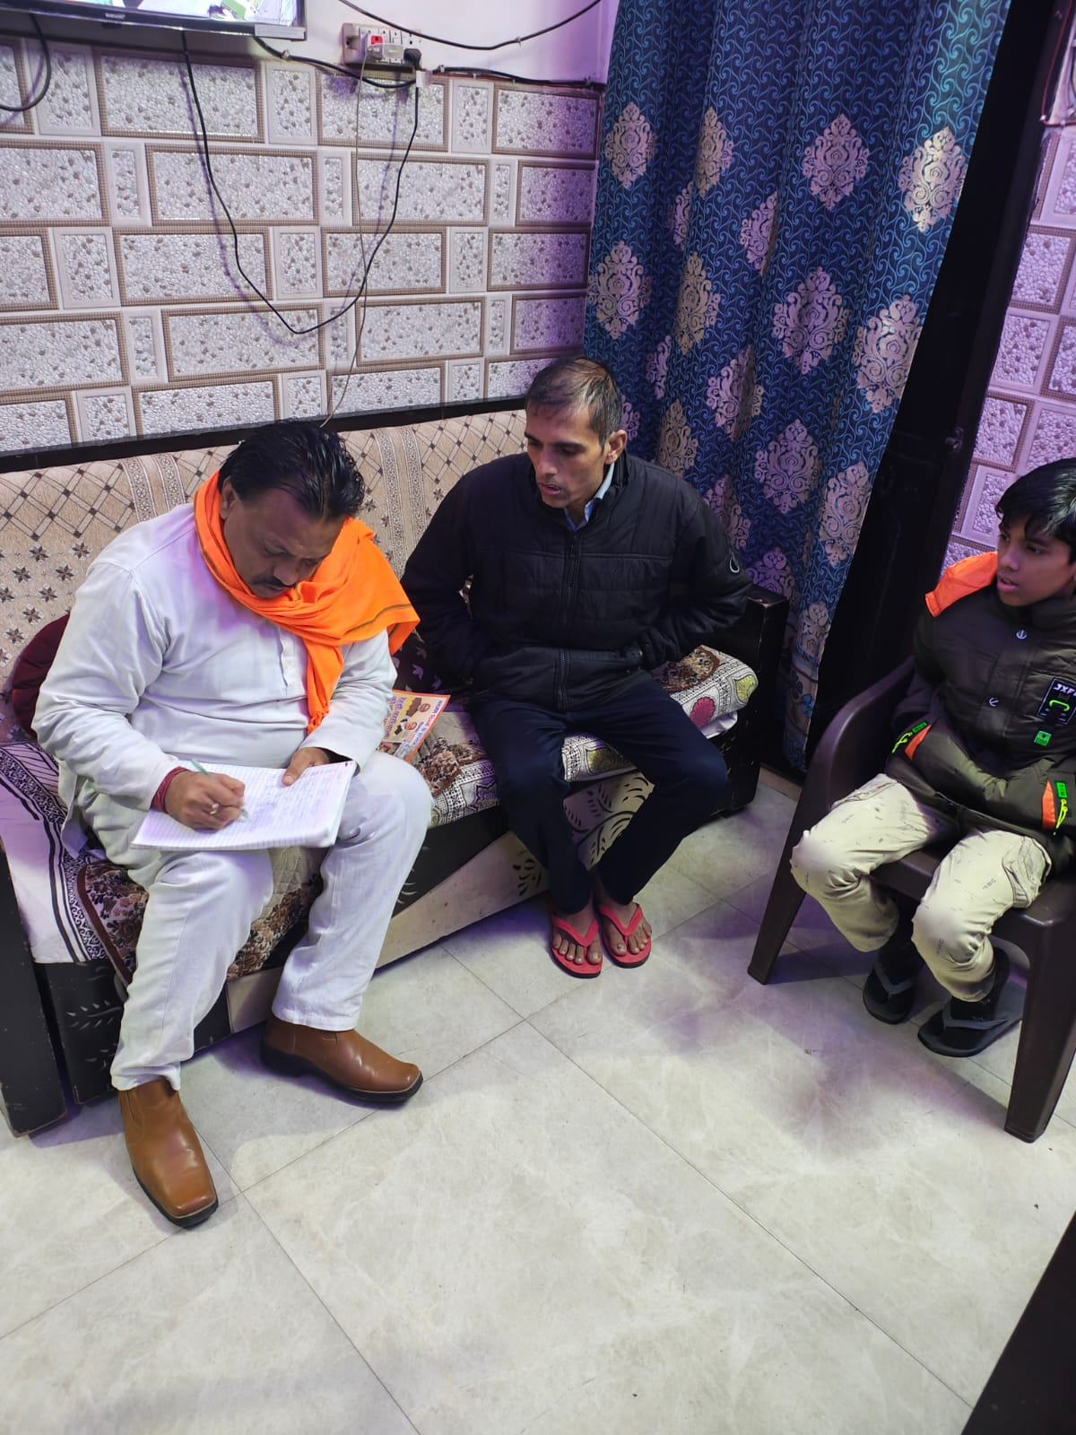
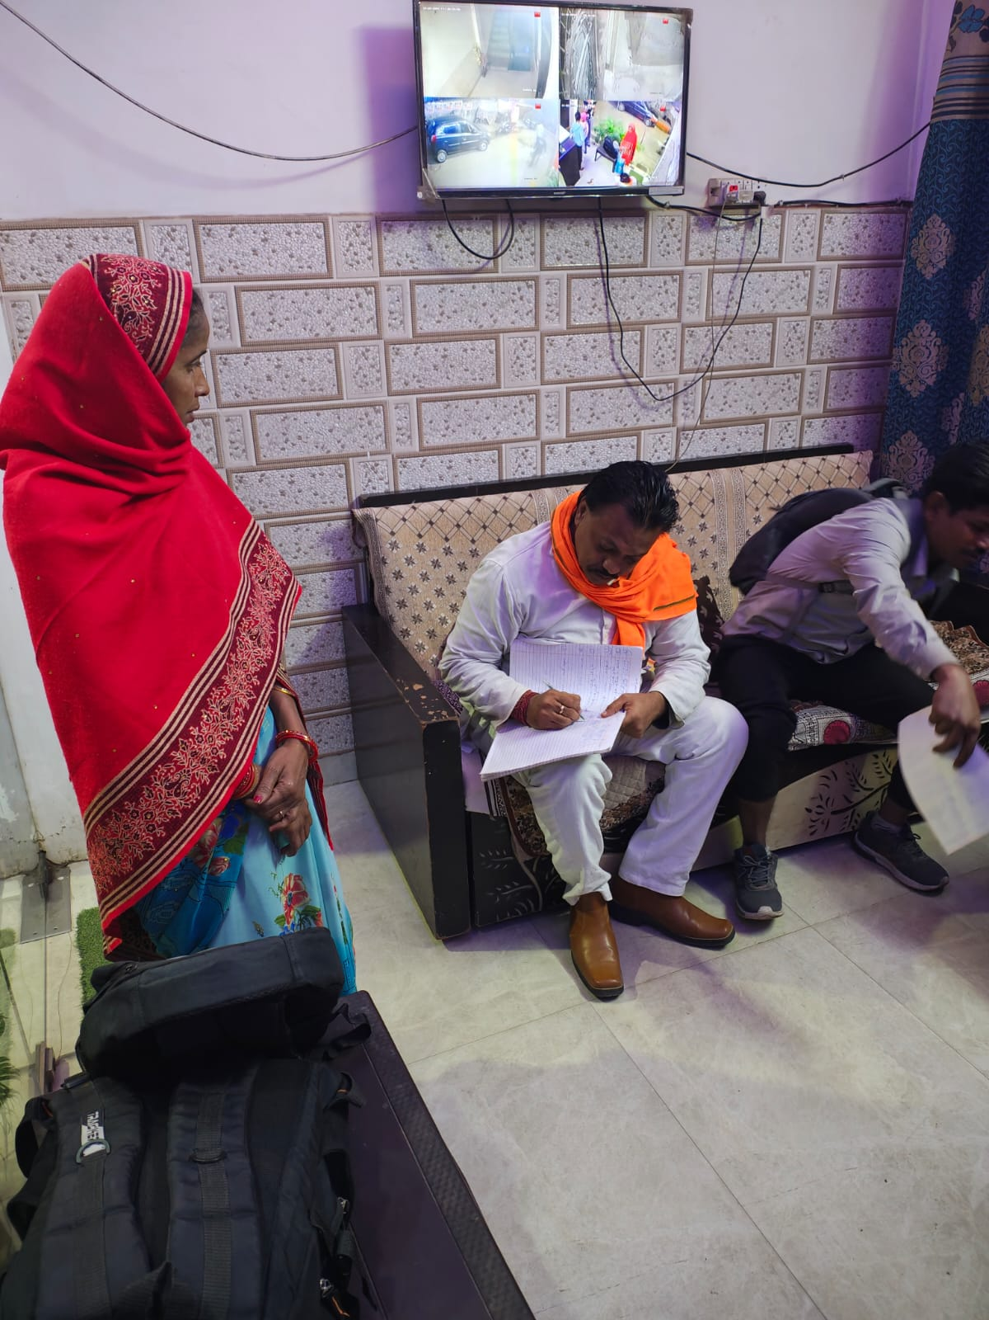
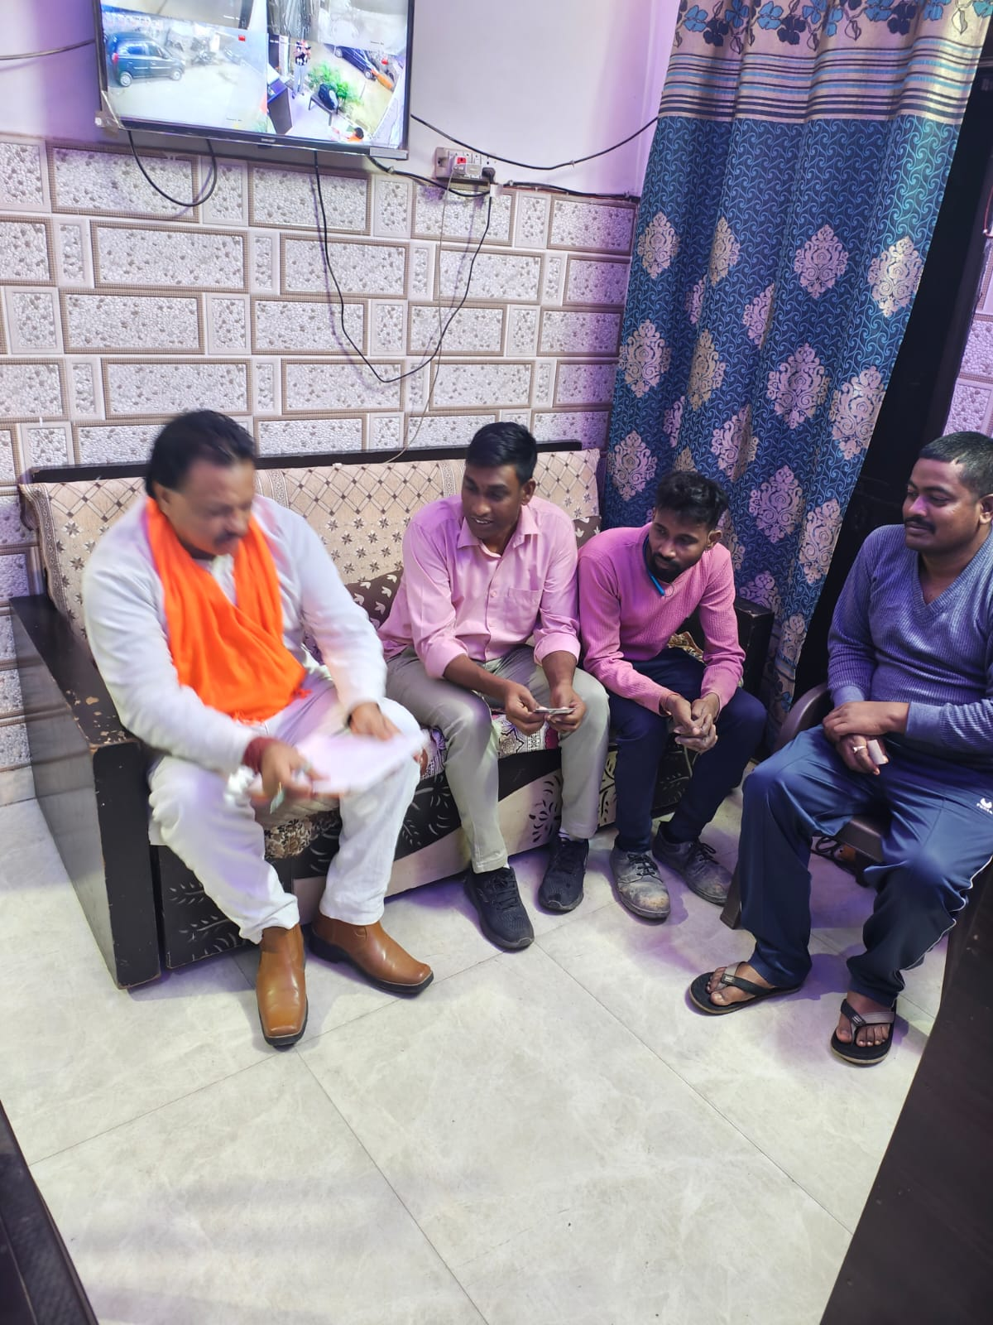
Helping the needy…

Slide 23
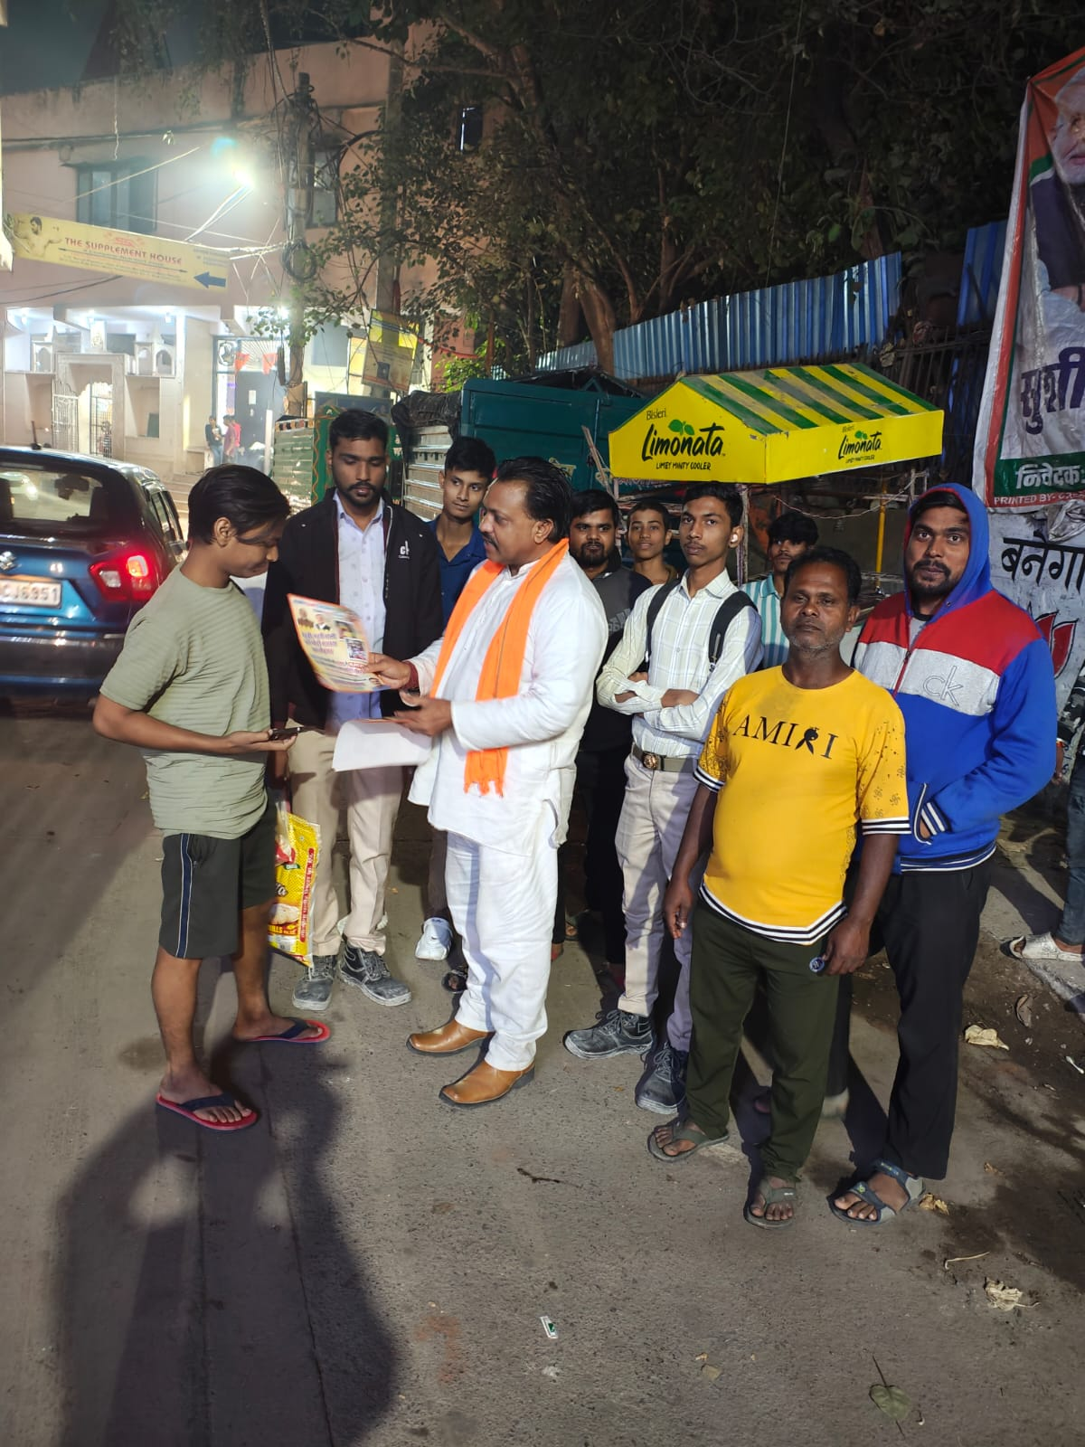
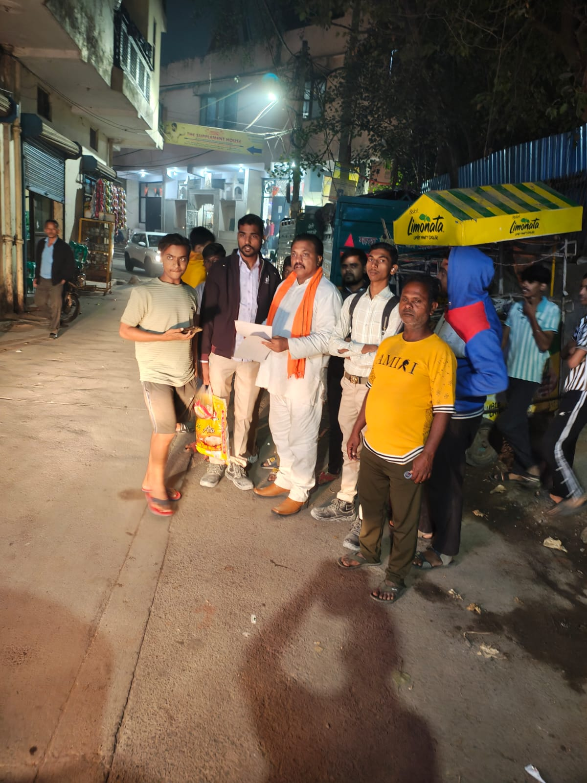
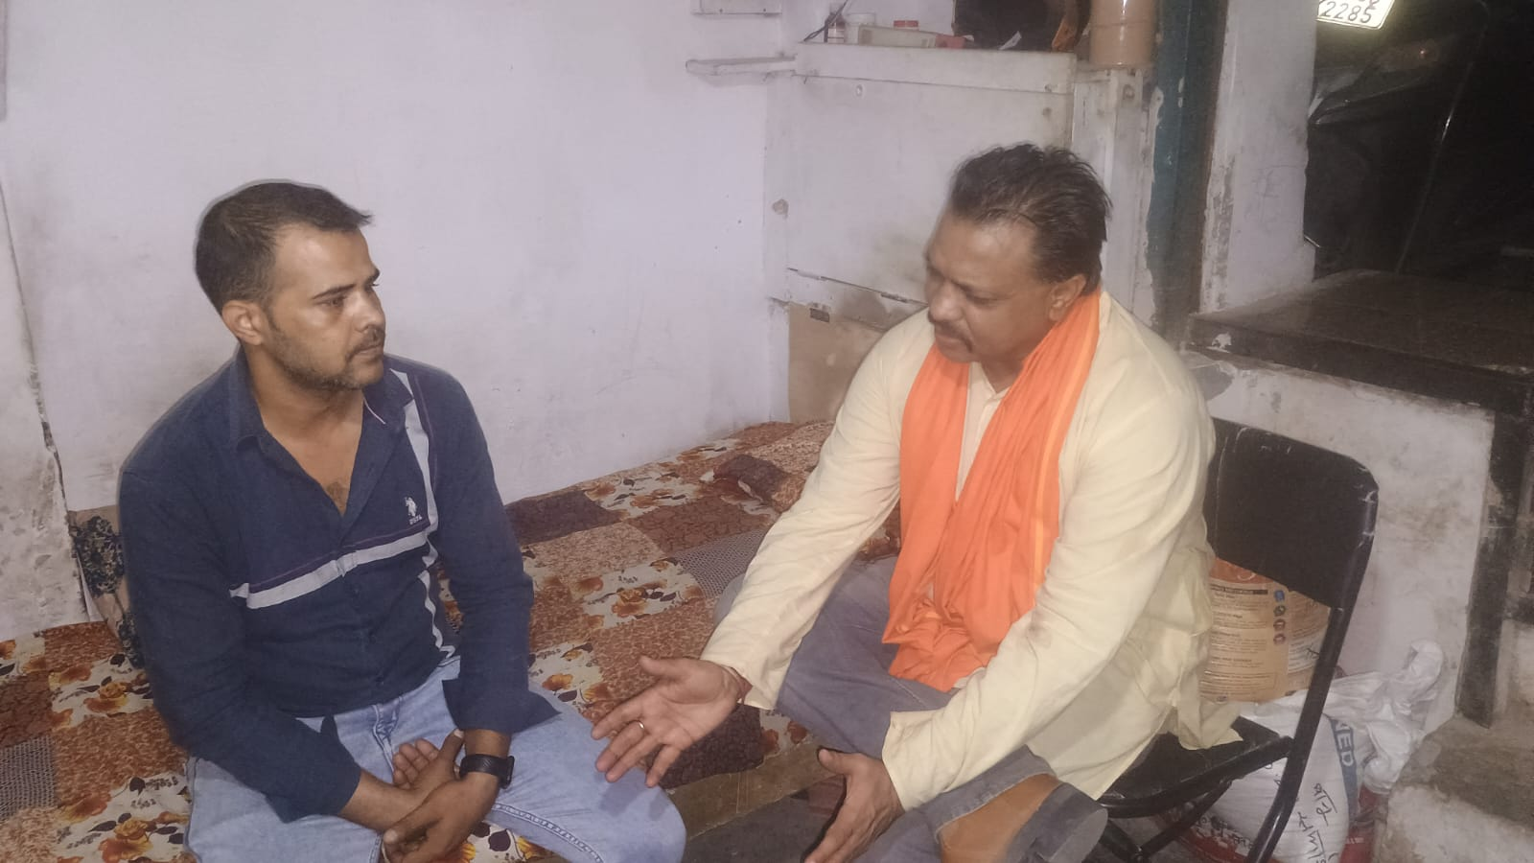
Awareness..

Slide 24
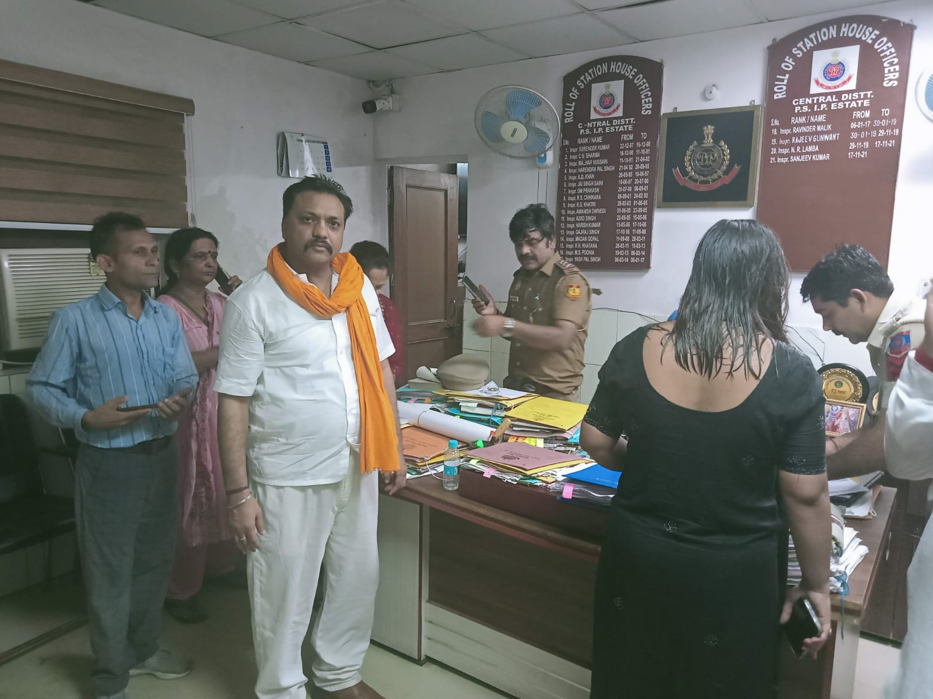
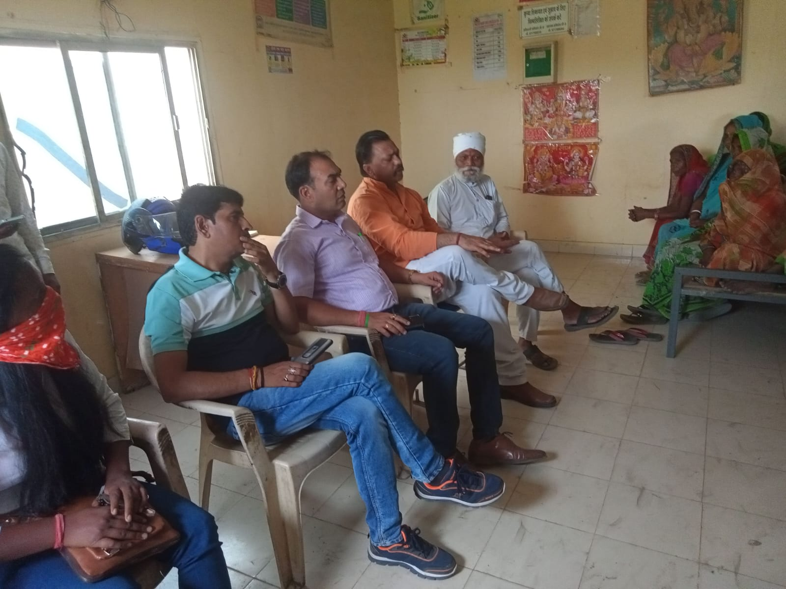
Grievance Redressal

Slide 25
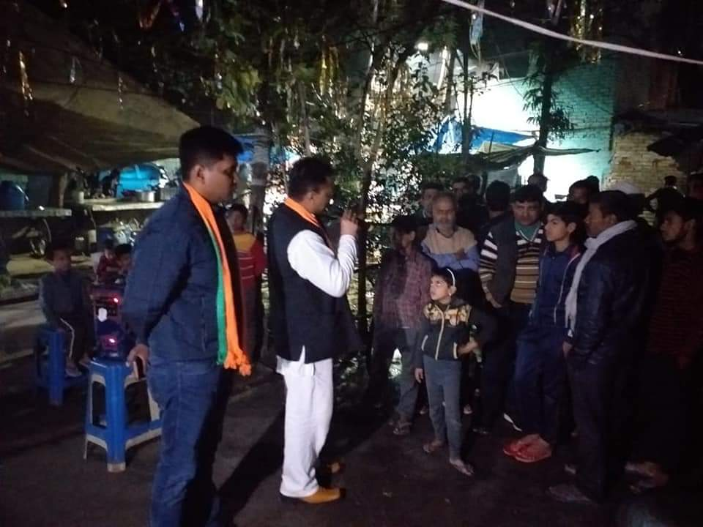
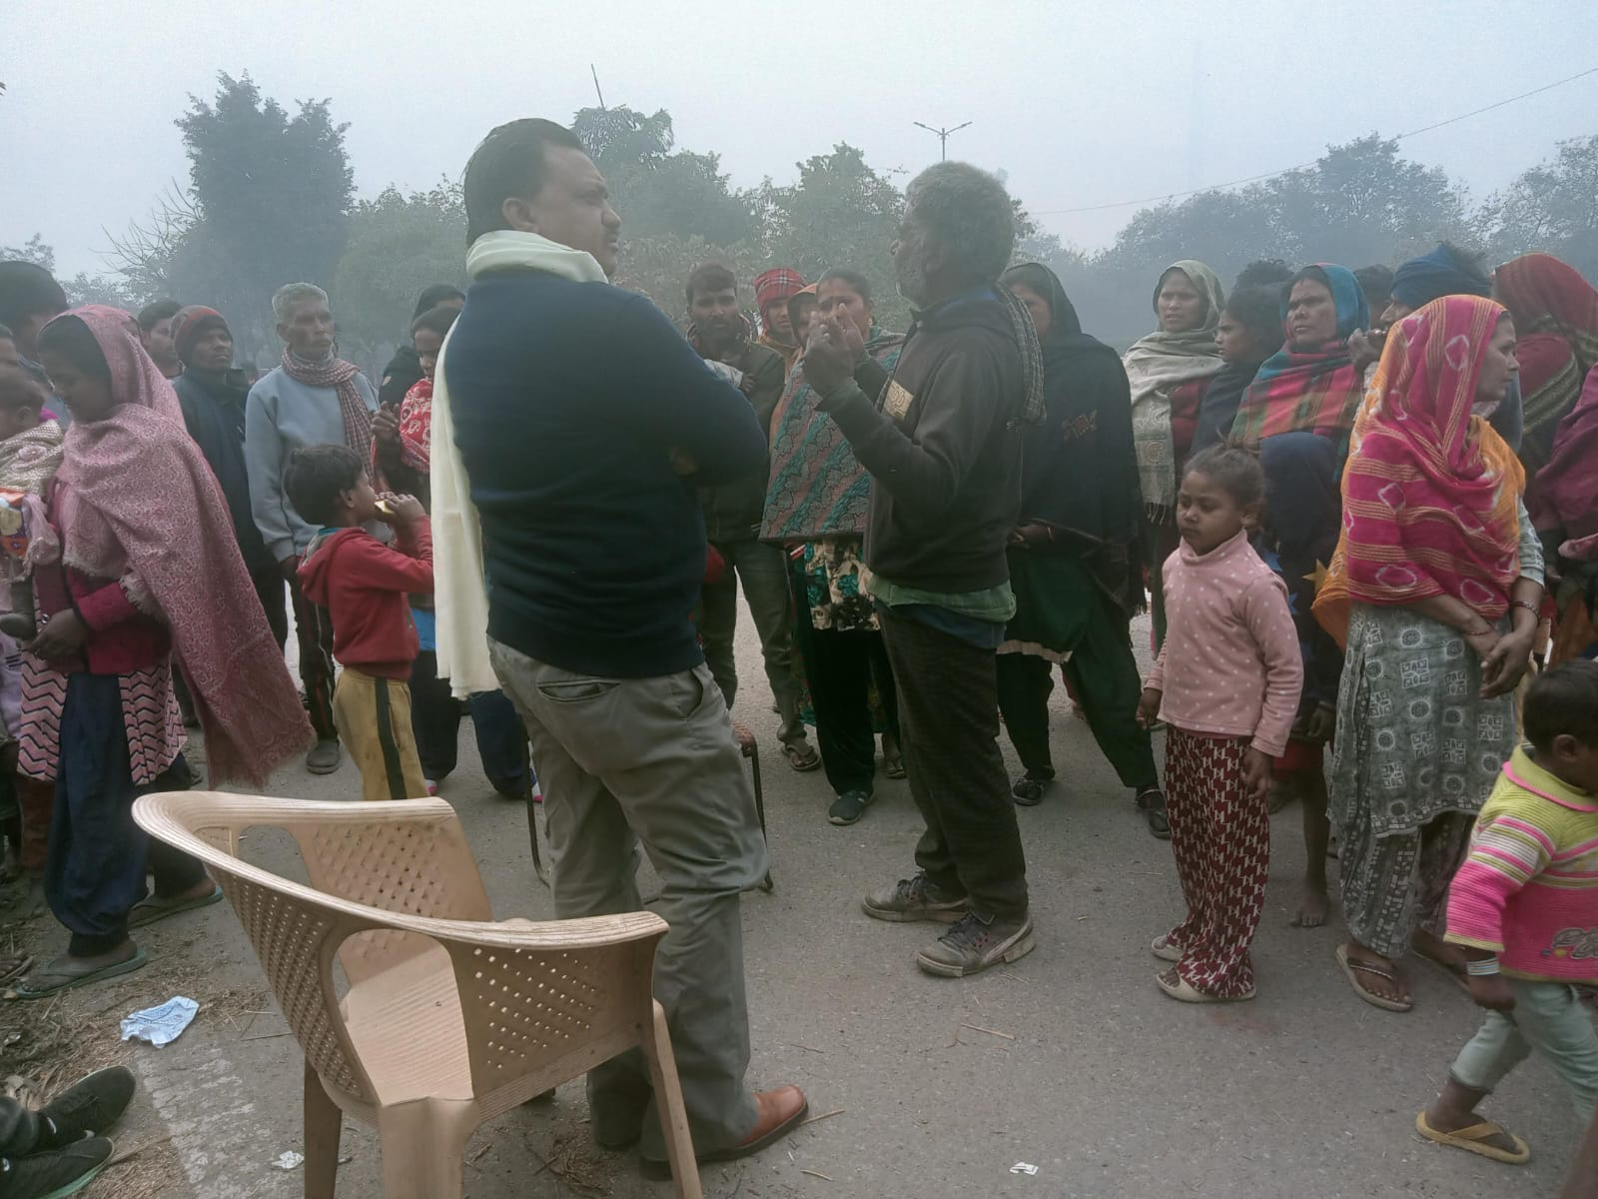
Interaction….

Slide 26
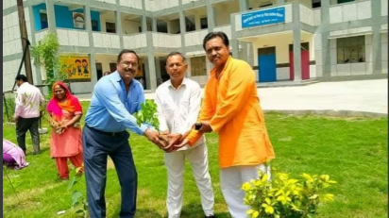
TREE PLANTATION DRIVE

Slide 27
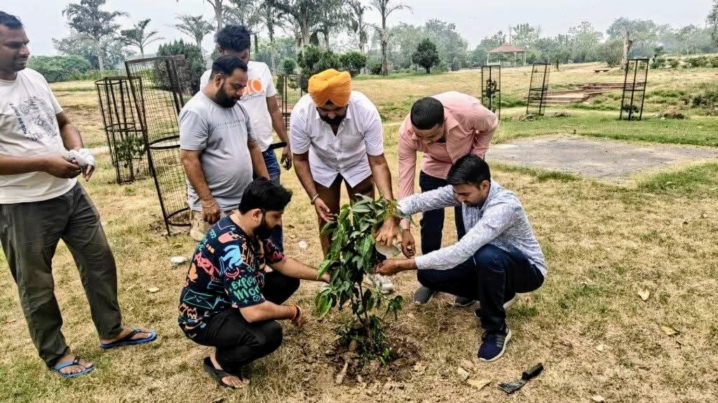

Slide 28
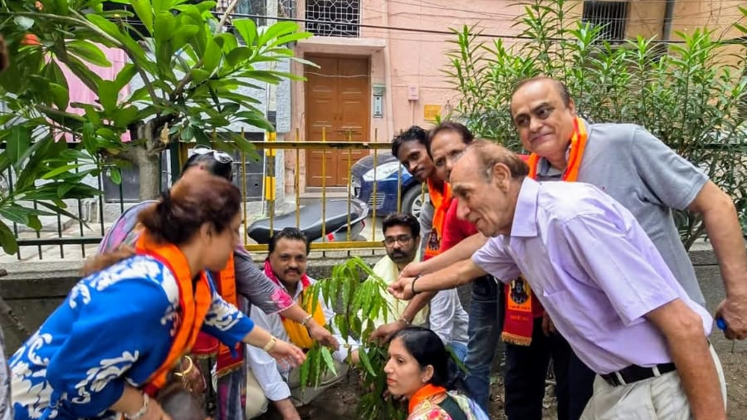

Slide 29
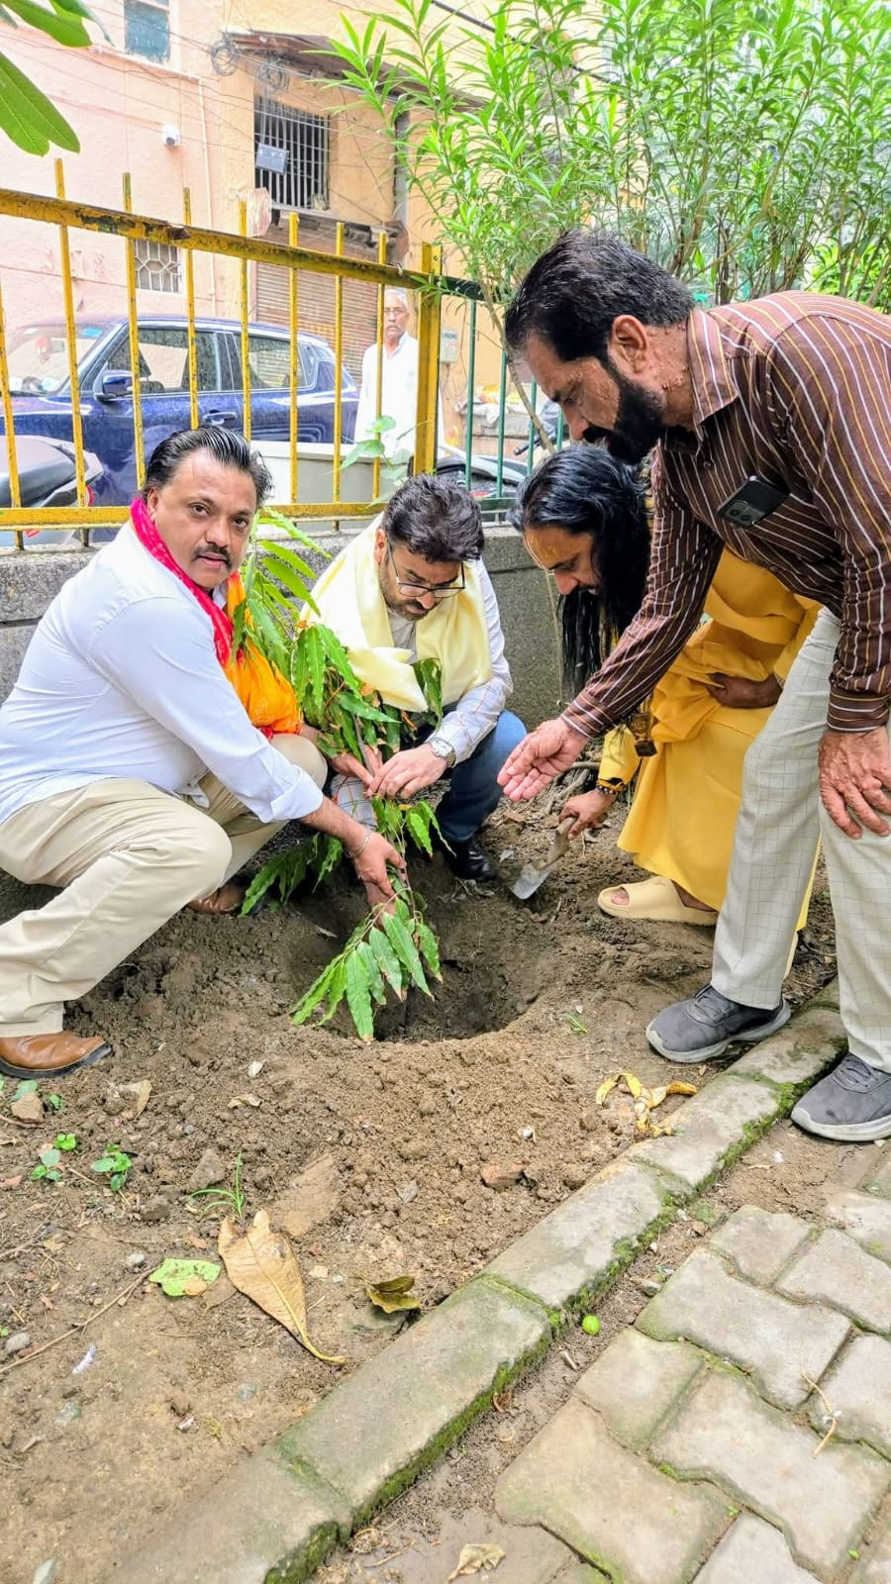
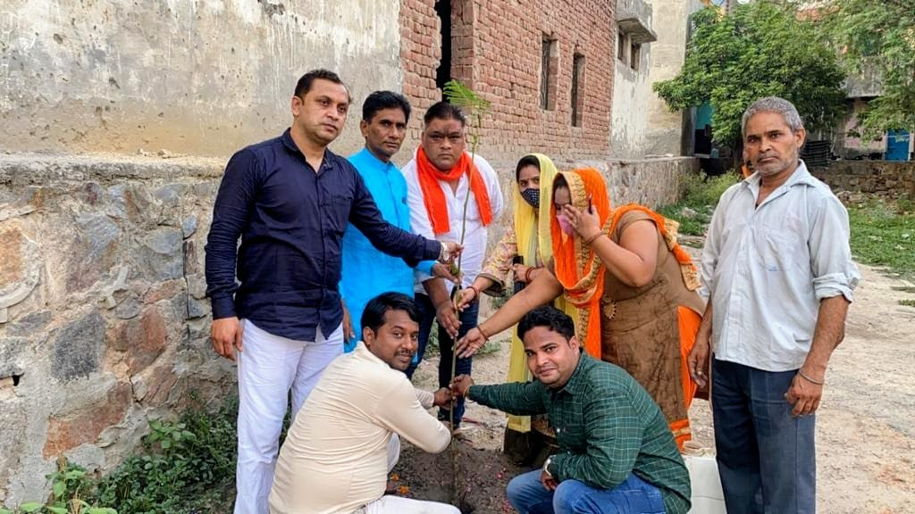

Slide 30
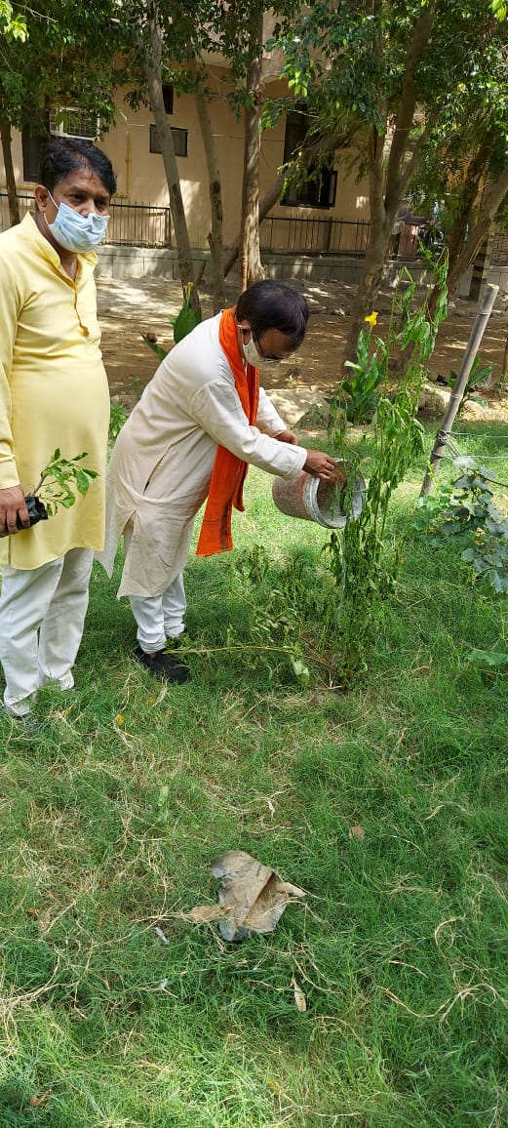
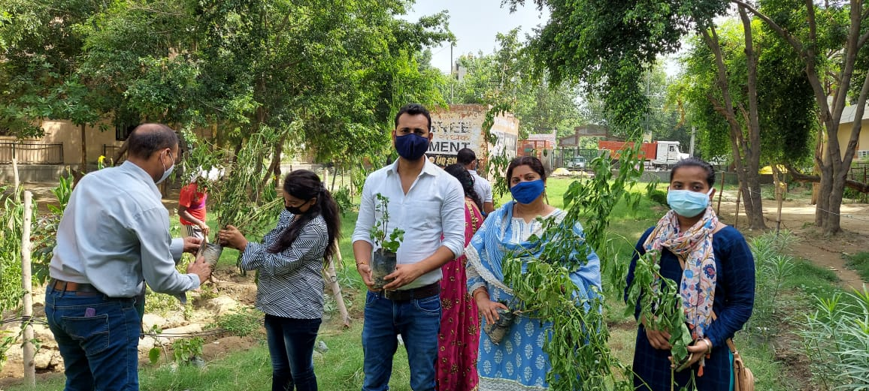

Slide 31
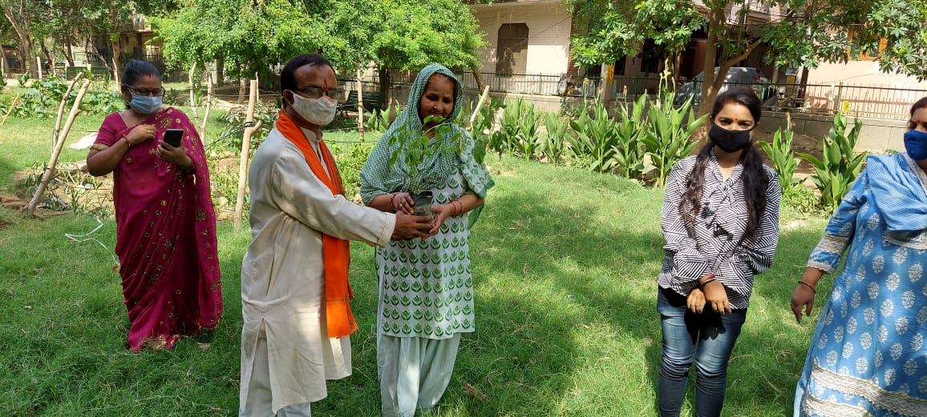

Slide 32
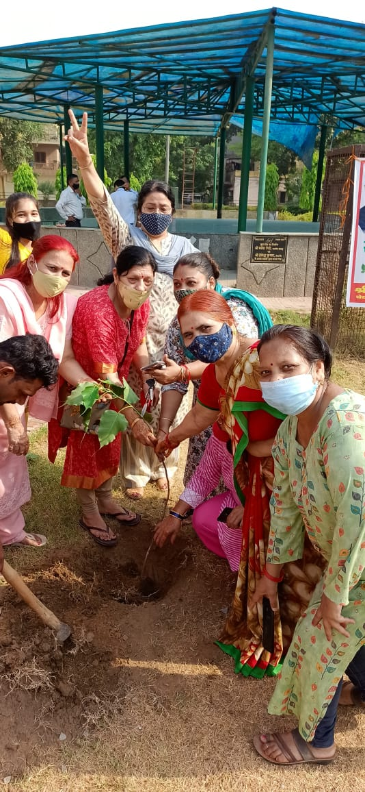
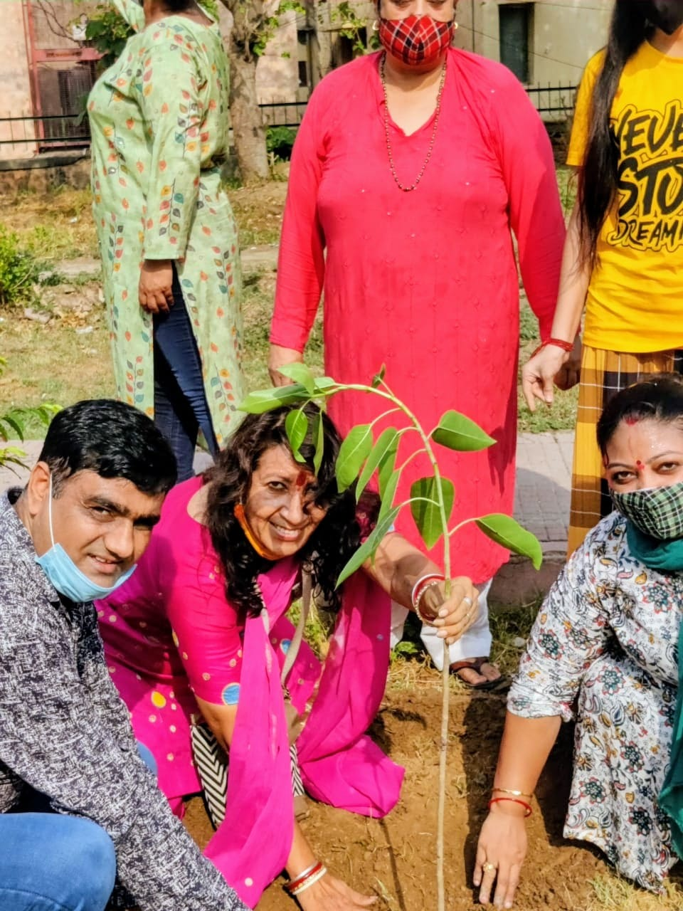

Slide 33
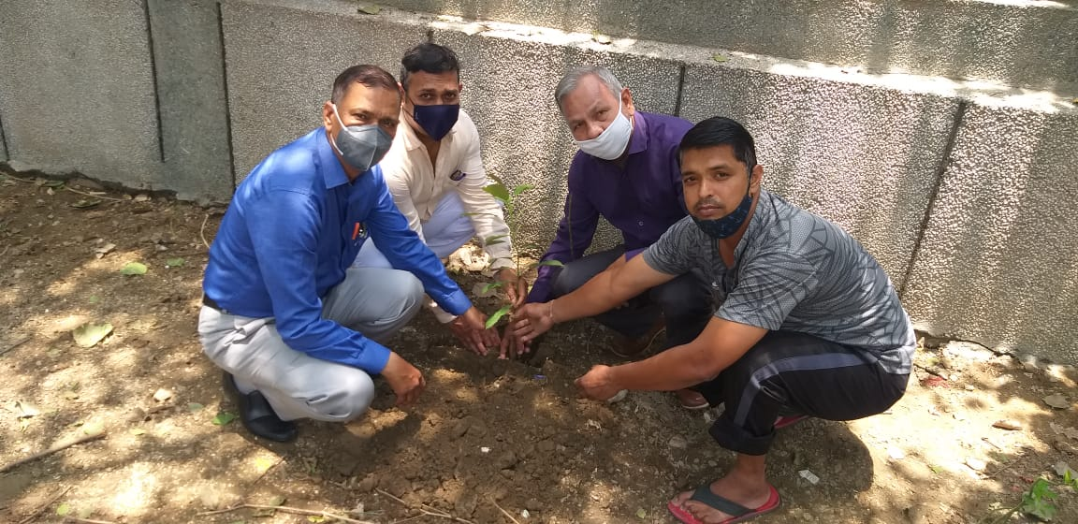

Slide 34
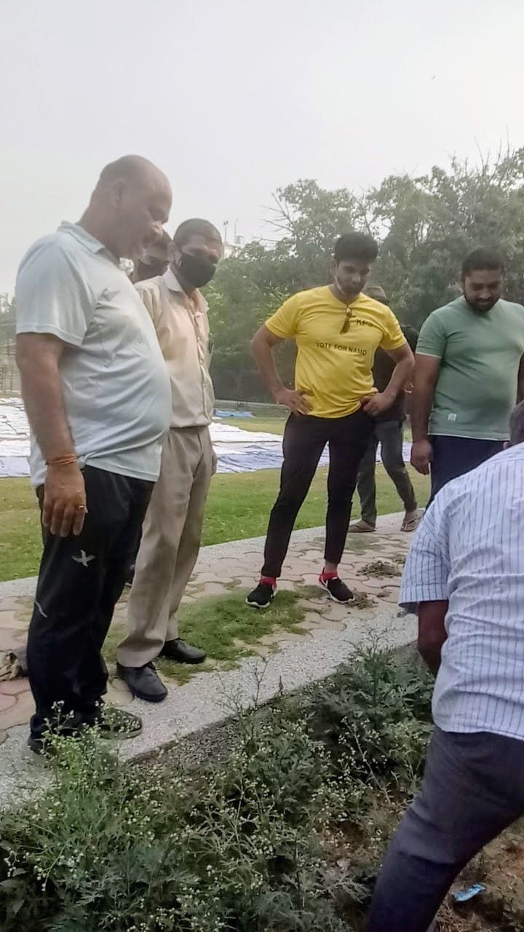

TREE PLANTATION DRIVE

Slide 35


NIGHT SHELTER

Slide 36

NIGHT SHELTER

Slide 37

HEALTH CAMPS

Slide 38

NIGHT SHELTER

Slide 39

HEALTH CHECKUPS

Slide 40

HEALTH CAMP

Slide 41

SLUM DWELLERS CAUSE

Slide 42

FOOD DISTRIBUTION

Slide 43



CLEANLINESS DRIVE

Slide 44

HELPING HAND

Slide 45

HELPING HAND

Slide 46


COVID TIMES

Slide 47

COVID TIMES

Slide 48

Video 1

Slide 49


Slide 50


Slide 51

HEALTH CARE

Slide 52


Slide 53


Slide 54


Slide 55


Slide 56


Slide 57


Slide 58


Slide 59


Medical Camp

Slide 60


Slide 61


Team

Slide 62
Contact Information:
For further information or collaboration, please contact:
Name: Heena Chauhan,President
Organization: Sarokar Nai Dishayen Welfare Society
Email: mailto: sarokaar2015@sarokarr.org
Website: Sarokarr.org
Phone: 9999250512, 7042497310

Slide 63
THANK YOU

